Slide 1
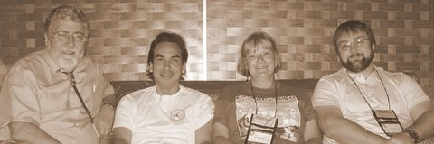
NIDA American Indian Research Scholars Mentorship Program
Bethesda, Maryland
October 14, 2009
Notes:
1

Slide 2
NIDA Native Scholars Workgroup
Ray Daw, MA New Mexico
Joseph Gone, PhD Michigan
Clyde McCoy, PhD Florida
Bernard Segal, PhD Alaska
Sallie Stevens, PhD Arizona
Pamela Jumper Thurman, PhD Colorado
Kamilla Venner, PhD New Mexico
R Dale Walker, MD Oregon
Karina Walters, PhD Washington
Deloris Big Foot, PhD Oklahoma
Dennis Norman, PhD Harvard
Associates

Slide 3
NIDA Support Staff
Lula A. Beatty, Ph.D. Chief, Special Populations Office National Institute on Drug Abuse/NIH 301-443-0441 lbeatty@nida.nih.gov
Kathy Etz, PhD, Epidemiology Research Branch. 301-402-1749 ketz@mail.nih.gov
Wilson M Compton, MD, MPE, Director, Division of Epidemiology, Services and Prevention Research

Slide 4
Workgroup Objectives
Education of public, students, health practitioners and researchers on addiction in the AI/AN/NH population as well as associated co-morbidities
Enhancing research competency
Developing research concepts
Grant application process
Understand maintain Native community based research
Mentoring

Slide 5
Presentation Objectives
Need for Mentoring
Logic Model
Expectations, Goals, Objectives
Establishing the Relationship
Working Together
Mentorship Webpage
Notes:
Ideally, the mentoring relationship should benefit trainee, mentor, sponsoring institution, and science. However, the reality is that not all successful researchers have had mentors, and not all mentor/trainee relationship end successfully. Each research institution has its own perspective on the value of mentoring, and how deeply it is willing to invest in the practice. Nevertheless, potential mentors and trainees should become familiar with likely responsibilities as well as the benefits and costs of this relationship.

Slide 6
Specific Native Disparity Concerns
>50% Native Americans entering as college freshman will leave after their first year.
Native American retention rate is 15% below the national average.
About 20 will enter college and only 3 will graduate with a four-year degree
Source: National Institute for Native Leadership in Higher Education, 2002
Major Shortage of American Indian Health Professionals

Slide 7
Why Develop a Native Mentoring Program?
Provide instruction on conducting research
Provide insight into Native identity – Personal and Community
Improve trainee's self-confidence
Critique and support trainee's research
Assist in defining and achieving career goals
Socialize trainee into the profession
Assist in development of collegial networks
Advise how to balance work and personal life
Assist in the development of future colleagues

Slide 8
NIDA Goals
Increase and retain underrepresented minority investigators (American Indian, Alaska Native and Native Hawaiian) conducting substance abuse and addiction research
Establish effective communication pathways for recruitment of new investigators or candidates for training positions at NIDA

Slide 9
Mentorship Goals
Mentor and train underrepresented minorities interested in substance abuse and addictions research
Pair Mentees with Mentors and encourage training, site visits, and professional development
Assist in identification and recruitment of candidates for NIDA training opportunities
Establish a website at oneskycenter.org to identify Mentors, Mentees, faculty/student interests and projects, and NIDA agenda.
Enhance Native community awareness and involvement

Slide 10
The 5 Elements of Mentoring Program
Recruit: Define eligibility, market program, conduct information sessions
Screen: applications, reference checks, interviews, orientation
Train: Overview of the program, role clarification, situational “how-to’s”
Match: Establish criteria, ensure all parties understand and agree to the terms and conditions of participation
Monitor: Continuing training opportunities, regular communication, goal setting and achievement, conflict resolution, documentation

Slide 11
Mentoring Logic Model
Predoctoral
Doctoral
Postdoctoral
Junior Mentor
Senior Mentor
Interactive Mentoring Relationships:
A mentee will have a primary mentor and have access to all mentors, mentees, their academic institutions and NIDA

Slide 12
Mentor Responsibilities: Competing ISSUES
Mentoring?
Advising
Community Involvement
Family
Tribal
Spiritual
Advocacy
Teaching Students
Clinical Service
Research
Academic Travel
Grant
Proposals
Personal Time

Slide 13
Students
Michael Dekker, DO, Resident in Psychiatry. Phoenix, Arizona
Dan Dickerson, DO, MPH. General Psychiatry and Addictions Psychiatry. Assistant Research Psychiatrist, U.C.L.A. Los Angeles, California
Jordan Lewis, MSW. Doctoral student, Interdisciplinary PhD, Dept. of Psychology. Resilience and Adaptation Program. University of Alaska, Fairbanks, Alaska
Sandra (Sandy) L. Momper, PhD. Assistant Professor of Social Work. School of Social Work. University of Michigan. Ann Arbor, Michigan
Olivia Belen Sloan, BA, Social Sciences, International Management and Culture. Masters student, and Coordinator, Training & Scholarship Program. Johns Hopkins Bloomberg School of Public Health, Center for American Indian Health. Baltimore, MD.
Melissa L Walls, PhD. Assistant Professor, Department of Sociology-Anthropology, University of Minnesota-Duluth, Minnesota
Erick Willie, BS, Psychology. Working on Masters Degree. Studying to be a medicine man. Gallup, New Mexico
James Wood, MS. Psychology. Doctoral student. Colorado State University. Fort Collins, Colorado
Notes:
Add info

Slide 14
Types of Contact
Face-to-Face
Especially for important and/or confidential issues
Have lunch/break together
Email
Alert mentees to programs and new information
For mentees to ask quick questions, seek direction
Reminders about programs, etc.
Phone
Setting up strategy meetings and touching base
When confidentiality and tone of voice are critical and email won’t do

Slide 15
Mentorship Activities
Attend scientific conferences with Native researchers and Native/Community themes and policy
Discuss research methods tailored to individual needs
A. Questions, design, statistics, ethics
B. Methods in community based research
3. Discuss grant applications and management
A. Writing proposals, find funding, career
development, writing papers, networking
B. Budgeting time, effort, and funds
C. Mock NIMH review sessions
4. Develop a scientific paper writing workshop

Slide 16
Attend Association of American Indian Physicians 38th Annual Meeting & National Health Conference
“Critical Issues in Indian Health: Science and Solutions for the Health of Our People”
1. N= 350, with 80 pre and med students
2. Reservation Community Setting
3. Alexandria, Virginia
4. July 22-26, 2009

Slide 17
Agenda for Group
Participate in orientation meeting
Attend conference and community activities
Meet throughout the conference with mentors, mentees, and others
Goal 1: Learn mentee-mentor personal goals and directions
Goal 2: Search for potential students and mentors
Goal 3: Experience a large Native/Scientific meeting with Federal officials, advisors

Slide 18
Attend 21st Annual Native Health Research Conference
“Science AS Storytelling and the
Science OF Storytelling”
1. N=600
2. Primary Native research meeting
3. National leaders in Native research
Portland, Oregon August 3-6, 2009

Slide 19
Agenda for Group
Meet throughout the conference with mentors, mentees, and students
Goal 1: Continue discussion of mentee-mentor personal goals and directions
Goal 2: Search for other potential students and mentors
Goal 3: Experience a large Native/Scientific meeting in a Native community setting

Slide 20
Trainee Self-assessment
What are my research ambitions?
What are my current research skills and knowledge?
What are some possible research interests I have?
What support do I need to pursue those research interests responsibly?
What is the timetable to completing my education/training?

Slide 21
Medical Student Elective at the Nimiipuu Health Clinic Lapwai, Idaho
Work directly with a Native physician in a primary health center
Goal to better understand the overall needs of Native communities on reservations
Learn to assess for alcohol and drug problems
Conduct literature searches to learn more about methamphetamine addiction, depression, and suicide among Native populations

Slide 22
Mentee 1
Monthly meeting with primary mentor
Regular email/phone contact with other mentors and mentees is great
2 conferences; met other Native professionals and wealth of valuable information, inspired my own research ideas
Now more interested in academics, making connections with leaders in the field
Have a specific plan for academic achievement

Slide 23
Mentee 2
This year: 2 grants;R-21 Nov 09, RO1 Mar 2010, almost complete.
Want to work with mentor to strategize toward funding possibilities and find opportunities outside of NIH
Publish at least 2 new manuscripts during the next year
Set to go up for tenure in 2012, Department wants mentee to go up early
A major stressor is teaching workload, University without major interest in grants and writing.

Slide 24
Mentee 3
Attended 2 conferences, presented a lecture and workshop. Received feedback from mentors
Exposure to excellent mentors with time and follow-up, provided reading and review of grant proposal
Traveled to New Mexico to meet with 2 mentors and one other mentee in CTN project
Submitted an R-21 grant this year with encouraging score, will resubmit after work with mentors

Slide 25
What Mentees May Gain:
Understanding of identity issues
Strategies for community problem solving
Greater chances for success in academics
Increased resilience through increased
resources
Gaining skills of learning in another mode
Valuing and understanding benefits of
mentor/protégé relationship

Slide 26
Mentorship: Areas for Discussion
Culture, politics, and identity
How to set special research plans (short and long)
Schedule for submitting articles and grant proposals
The publication process
Course planning, teaching strategies, mentoring students
Departmental relations
Time management and professional/personal balance
Tenure and promotion process and expectations
Substantive, theoretical and methodological interests

Slide 27
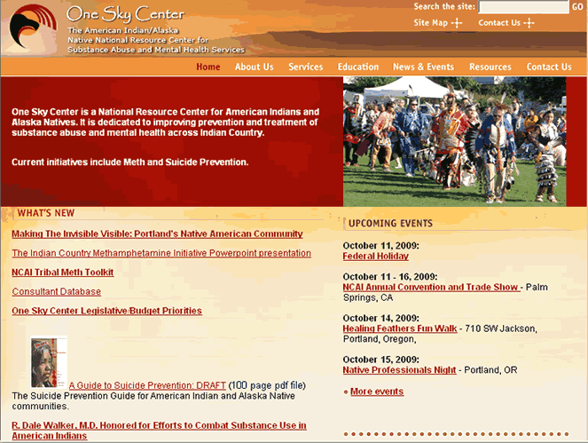
One Sky Center Website

Slide 28
Mentorship Section

Slide 29
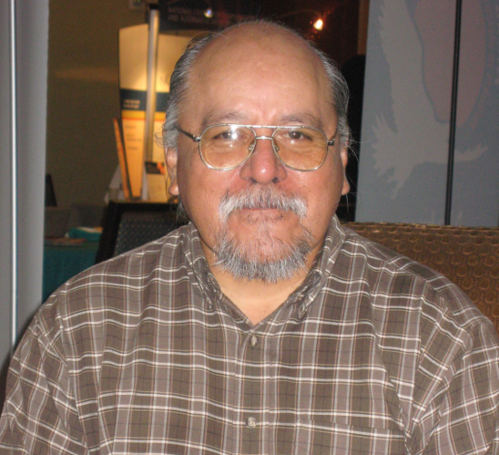
Future Plans
Select four more mentees
Further refine the mentor role
Recruit senior non-Native researchers as associates
Continue to develop relationships with the IHS and professional health organizations
Develop a National University Consortium for Native Health Research
Apply for National Mentoring Network Grant

Slide 30
Contact us at
503-494-3703
E-mail
Dale Walker, MD
onesky@ohsu.edu
Or visit our website:
www.oneskycenter.org

