Slide 1

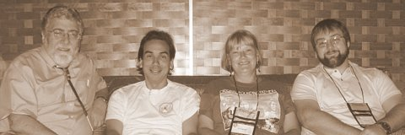
Connections and Collaborations: Addressing Research Training Needs of American Indian/Alaska Native Students and Faculty
National Institute on Drug Abuse DIVERSITY ALUMNI MEETING
Bethesda, Md. November 7, 2011
Notes:
Abstract:
The American Indian/Alaska Native population comprises about 1.5 percent of the U. S. population or approximately 4.5 million people. Their representation in research and science is low which is also seen in their low representation in leadership positions in academia, government and professional associations. Given these low numbers, the importance of establishing a critical mass of Ai/AN scholars across discipline and professional boundaries will be discussed and the role that the AI/AN can play in this process. The presenter will also discuss efforts to increase the participation of American Indian/Alaska Native scholars in research and leadership position, focusing on the role of the Association of American Indian Physicians and a Native Mentorship Program in Addictions. The Native Mentorship program recruits AI/AN scholars across the educational and career pipeline and pairs them with established mentors from varying disciplines to encourage their participation in substance abuse research and related health concerns of AI/AN communities. They receive skills training in areas such as scientific writing and grant development, but most importantly they are encouraged to become deep thinkers and proficient advocates for American Indian health issues. Outcomes of the first cohort of mentees will be shared. Other topics that will be addressed include coalition building and networking with other groups, especially psychologists, and professional associations to maximize efforts and gain allies, challenges of recruiting AI/NA scholars into research and academia, and concerns about the development of community informed, evidence-based practices appropriate for AI/AN.
1

Slide 2
Presentation Objectives
Introduce Mentors and Mentees
Show Goals and Objectives
Explain Why the Need for Mentoring
Present a Mentor Logic Model
Establish and Assess Working Relationships
Notes:
Ideally, the mentoring relationship should benefit trainee, mentor, sponsoring institution, and science. However, the reality is that not all successful researchers have had mentors, and not all mentor/trainee relationship end successfully. Each research institution has its own perspective on the value of mentoring, and how deeply it is willing to invest in the practice. Nevertheless, potential mentors and trainees should become familiar with likely responsibilities as well as the benefits and costs of this relationship.

Slide 3
NIDA Native Scholars Workgroup and Mentors
Workgroup Member and Mentors:
Additional Mentors:
Deloris Big Foot, PhD, Oklahoma
Ray Daw, MA , New Mexico (Co-Chair)
Joseph Gone, PhD, Michigan
Clyde McCoy, PhD, Florida
Dennis Norman, PhD , Massachusetts
Bernard Segal, PhD, Alaska
Sallie Stevens, PhD, Arizona (On leave)
Pamela Jumper Thurman, PhD, Colorado
Kamilla Venner, PhD, New Mexico
R. Dale Walker, MD, Oregon (Co-Chair)
Karina Walters, PhD, Washington
Art Blume, PhD, Washington
Jared Jobe, PhD, Virginia
Jenny Joe, PhD, MPH, Arizona
Theresa LaFromboise, PhD, California
Patricia Silk Walker, PhD, Oregon
Wayne Zundel, PhD, Oregon
____________________
Associate Mentors

Slide 4
NIDA Native-to-Native Mentees
Original Mentee
Dan Dickerson, DO, MPH
Sandra Momper, PhD
Melissa Walls, PhD
James Wood, MS, PhD
Ericke Willie, MS
New in 2010
Michelle Begay, MS
Jami Bartgis, PhD
Melissa Deer, MD
Caleb Dunlap, BS
Jared Dunlap, BS
Jacque Gray, PhD
Danielle Tsingine, BS
Julie Yaekel Black Elk, PhD
New in 2011
Kelsey Motanic, BA
Kimberly Johnson, MS
Jeanene McCoy Bengoa, BS
Kimberly A. Miller, PhD
Andrea Martel, MS
Lana Beasley, PhD
Alumni: (Original Mentee)
Michael Dekker, DO
Olivia Belen, BS
Jordan Lewis, PhD
Total : 22

Slide 5
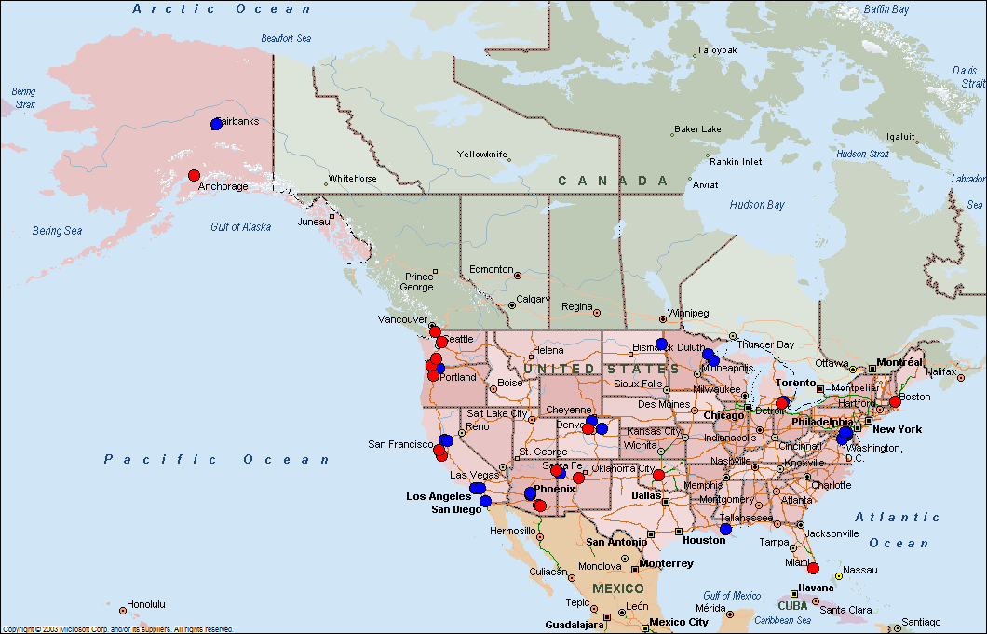
NIDA Native Mentorship Map
Mentors: 17
Mentees: 22

Slide 6
Why Develop a National Native Mentoring Program?
Provide instruction on conducting research
Provide insight into Native identity – Personal and Community
Improve trainee's self-confidence
Critique and support trainee's research
Assist in defining and achieving career goals
Socialize trainee into the profession
Assist in development of collegial networks
Advise how to balance work and personal life
Assist in the development of future colleagues

Slide 7
American Indian Faculty in degree-granting institutions: Fall 2009
Source: Digest of Education Statistics: 2010, Table 256; http://nces.ed.gov/programs/digest/d10/tables/dt10_256.asp?referrer=list
Notes:
Source: Digest of Education Statistics: 2010, Table 256
http://nces.ed.gov/programs/digest/d10/tables/dt10_256.asp?referrer=list

Slide 8
Native Mentorship Goals
Mentor and train American Indian students and early career faculty interested in substance abuse and addictions research
Pair Mentees with Mentors and encourage training, site visits, and professional development
Assist in identification and recruitment of candidates for NIDA training opportunities
Maintain a website at www.oneskycenter.org to identify Mentors, Mentees, faculty/student interests and projects, and NIDA agenda.
Enhance Native community awareness and involvement
Attend and participate in National Scientific Conferences that focus on American Indian Health and/or addictions research

Slide 9
The 5 Elements of Mentoring Program
Recruit: Define eligibility, market program, conduct information sessions
Screen: applications, reference checks, interviews, orientation
Train: Overview of the program, role clarification, situational “how-to’s”
Match: Establish criteria, ensure all parties understand and agree to the terms and conditions of participation
Monitor: Continuing training opportunities, regular communication, goal setting and achievement, conflict resolution, documentation

Slide 10
Native Mentoring Logic Model
Predoctoral
Doctoral
Postdoctoral
Junior Mentor
Senior Mentor
Interactive Mentoring Relationships:
A mentee will have a primary mentor and have access to all mentors, mentees, their academic institutions, NIDA and NIAAA

Slide 11
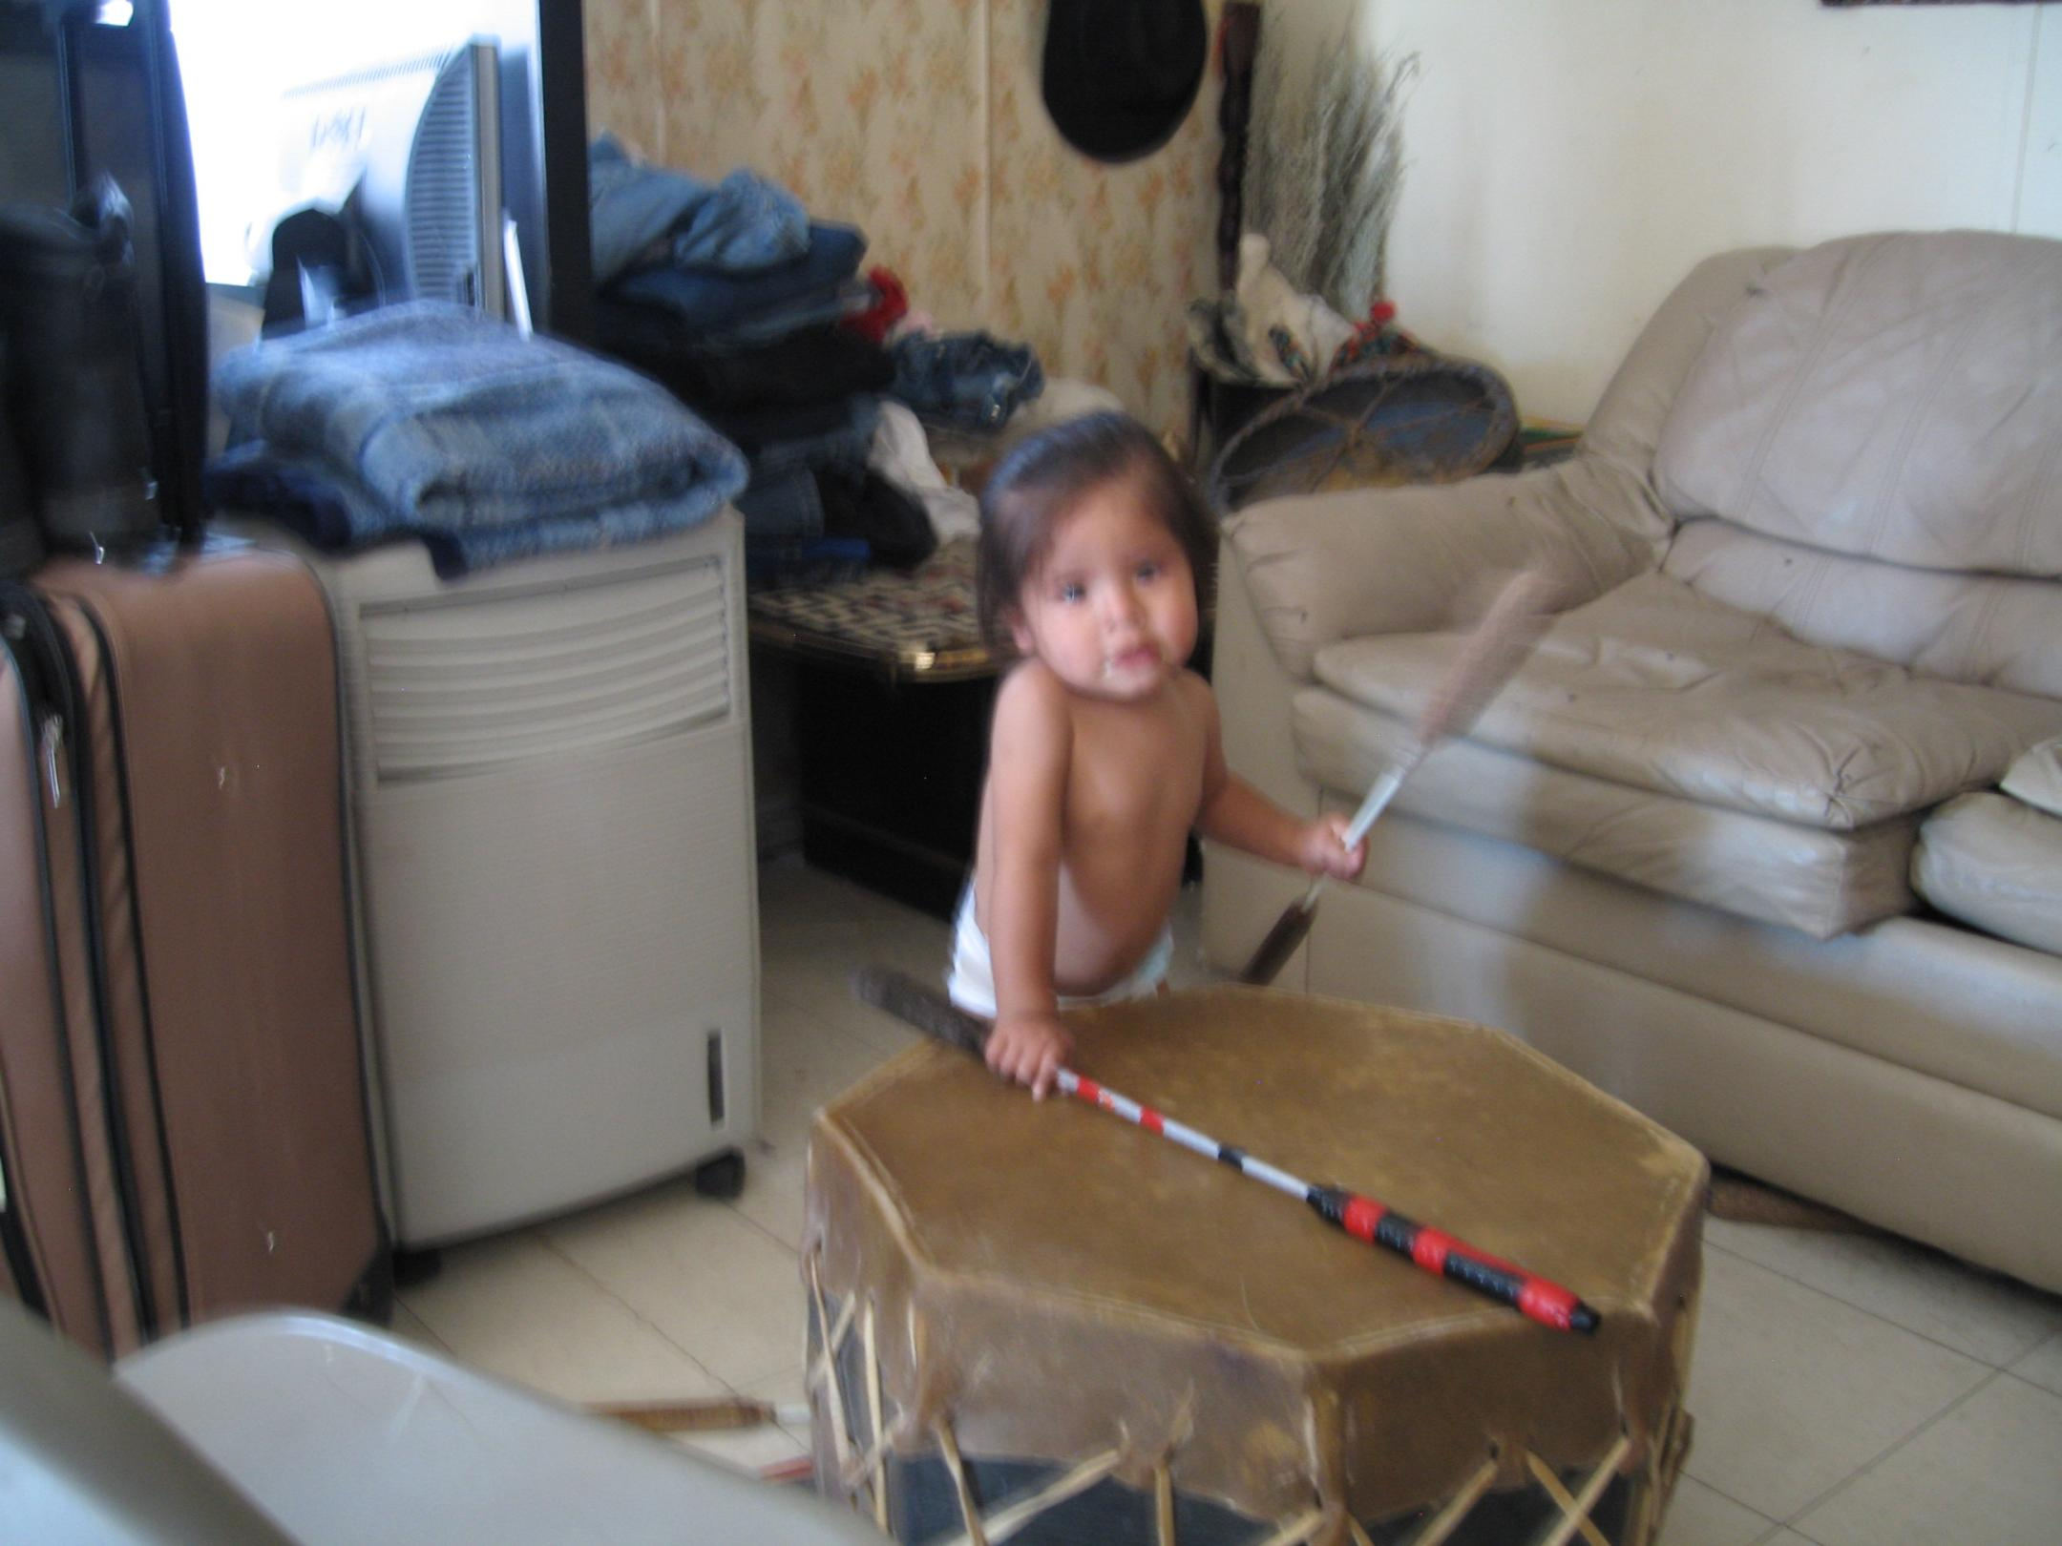
Mentor Responsibilities:
Competing ISSUES
Mentoring?
Advising
Community Involvement
Family
Tribal
Spiritual
Advocacy
Teaching Students
Clinical Service
Research
Academic Travel
Grant
Proposals
Personal Time

Slide 12
Types of Mentorship Contact
Face-to-Face
Especially for important and/or confidential issues
Attend national and regional conferences as mentor/mentee teams
Discuss career objectives and strategies to accomplish those
Co-present at conferences
Have lunch/break together at meetings
E-mail
Alert mentees to programs and new information
For mentees to ask quick questions, seek direction
Reminders about programs, etc.
Phone
Set up strategy meetings and touch base
When confidentiality and tone of voice are critical, face-to-face is not practical and email won’t do
Web site
Reference materials, data links and news

Slide 13
Mentorship Activities
Attend scientific conferences with Native researchers and Native/Community themes and policy
Discuss research methods tailored to individual needs
A. Questions, design, statistics, ethics
B. Methods in community based research
3. Discuss grant applications and management
A. Writing proposals, find funding, career
development, writing papers, networking
B. Budgeting time, effort, and funds
C. Mock NIMH review sessions
4. Develop Mentee-needs specific Workshops

Slide 14
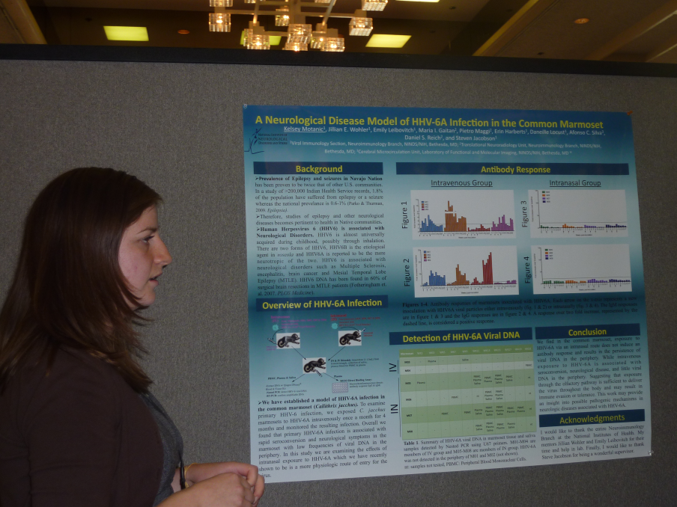
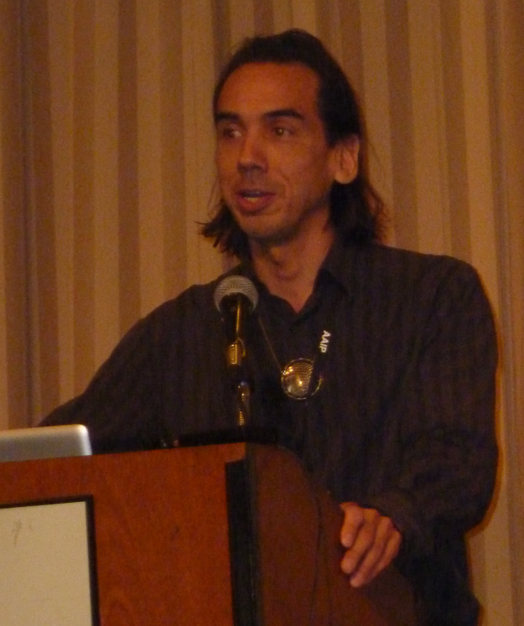
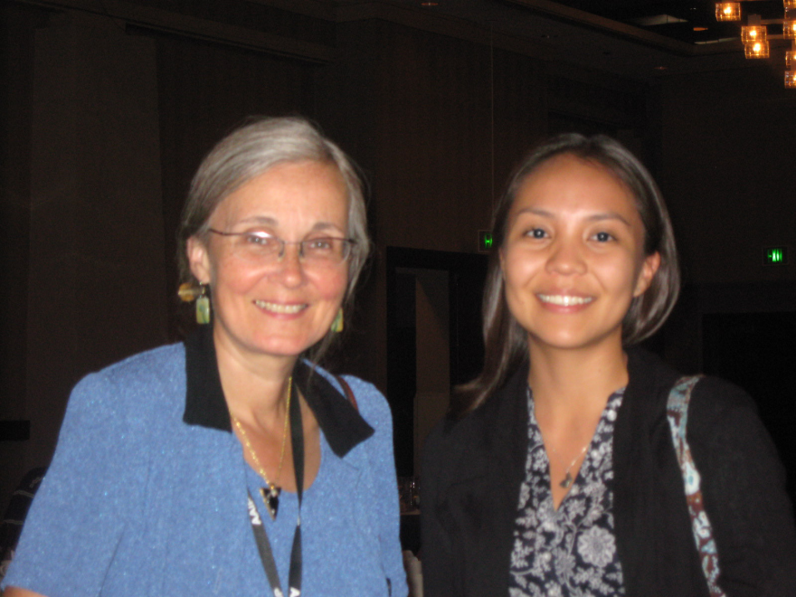
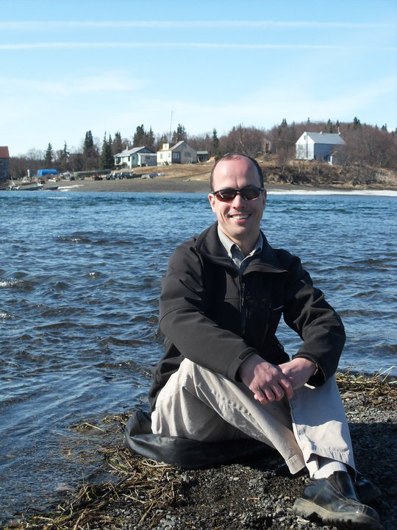
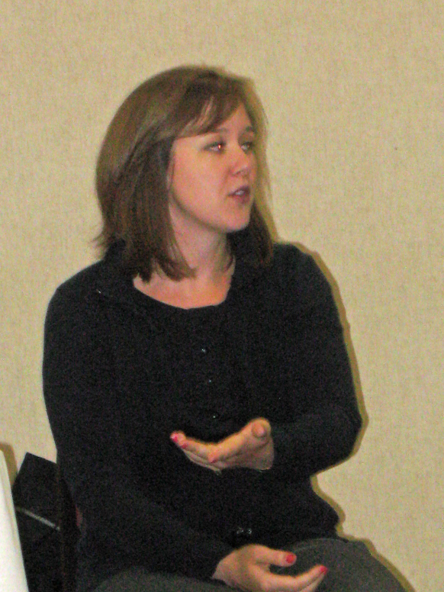
Mentee Activities

Slide 15
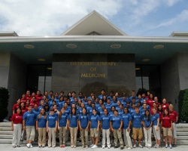
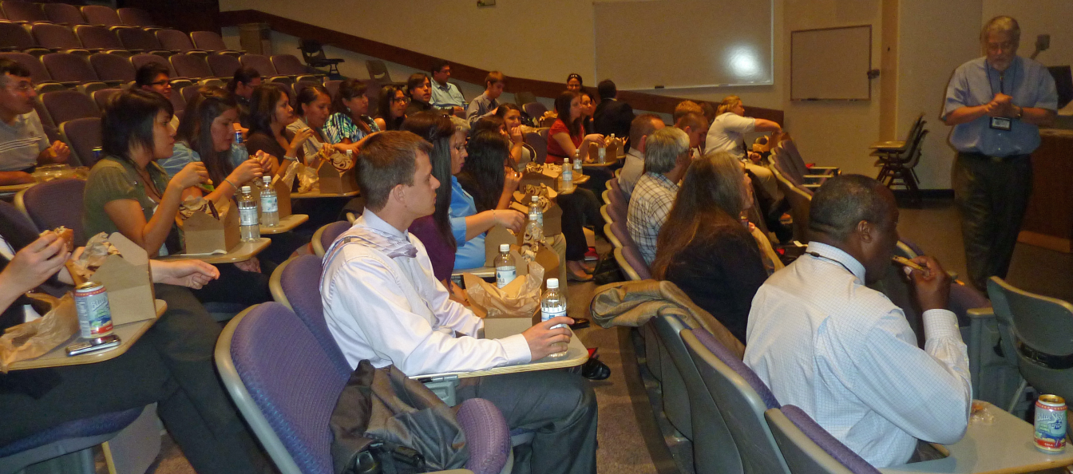
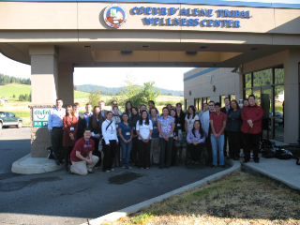
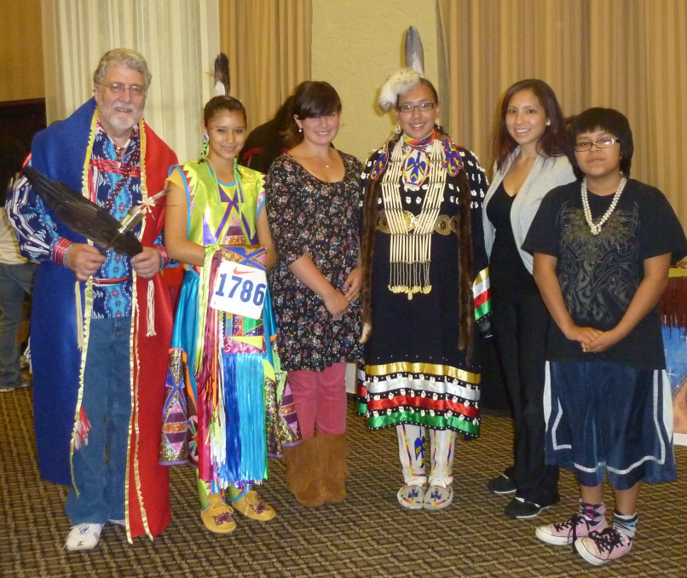
Adding to the Pipeline

Slide 16
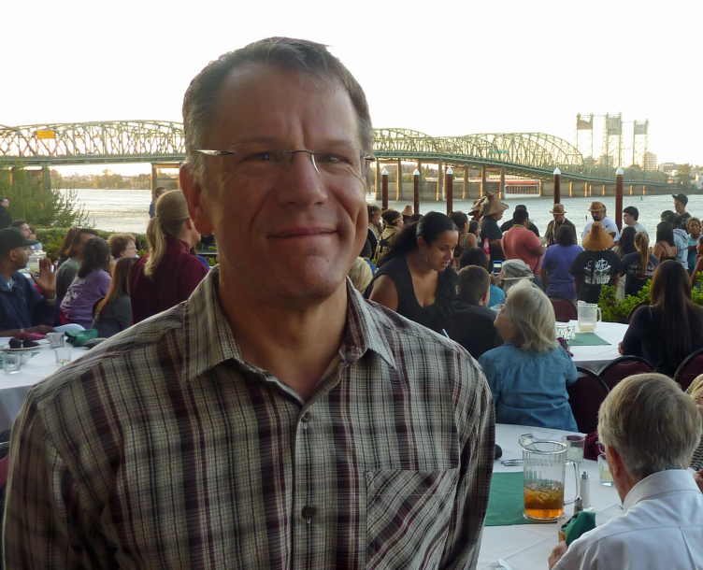
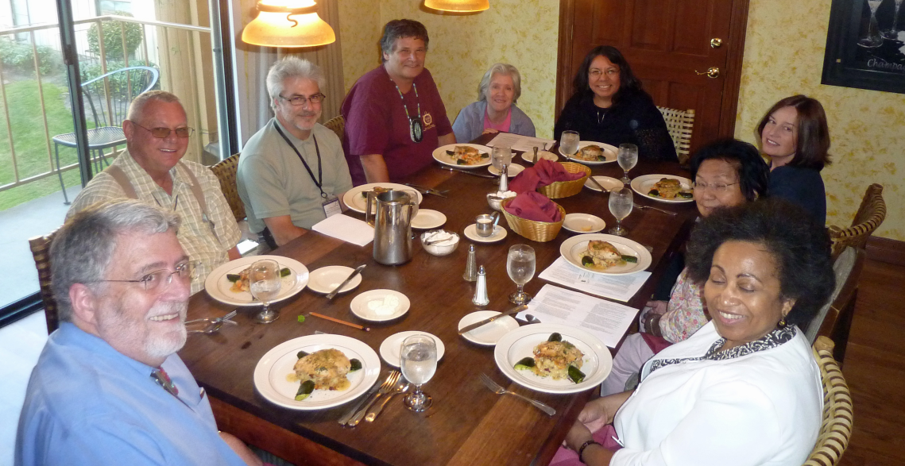
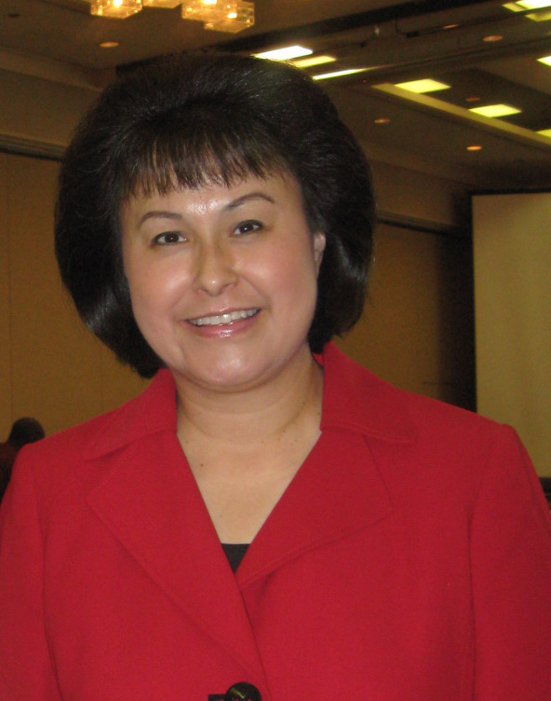
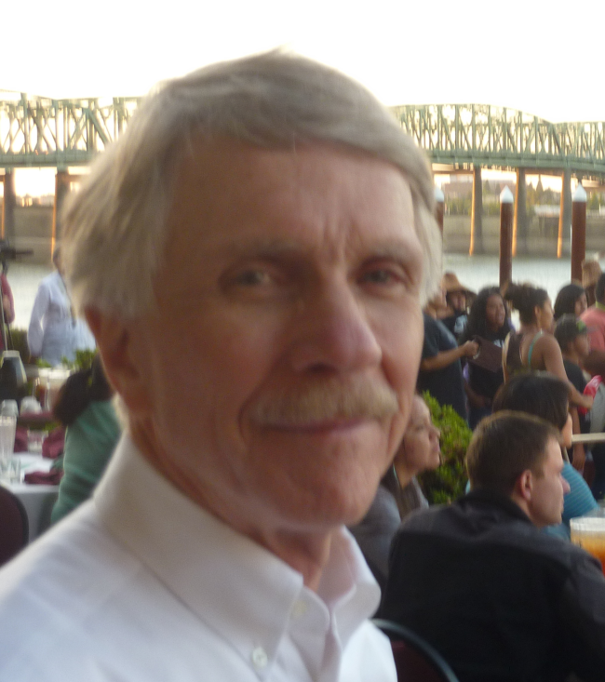
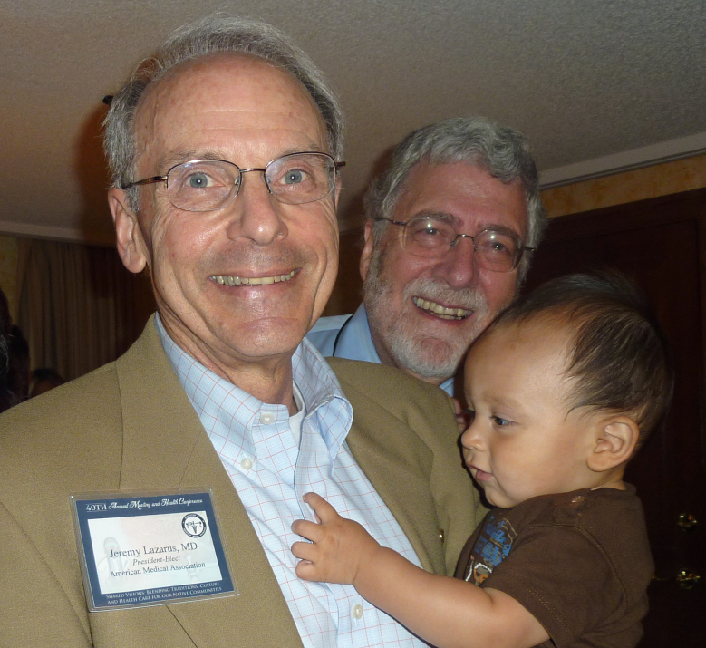
Meet and Interact with Leadership

Slide 17
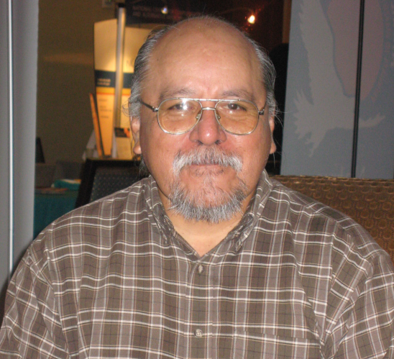
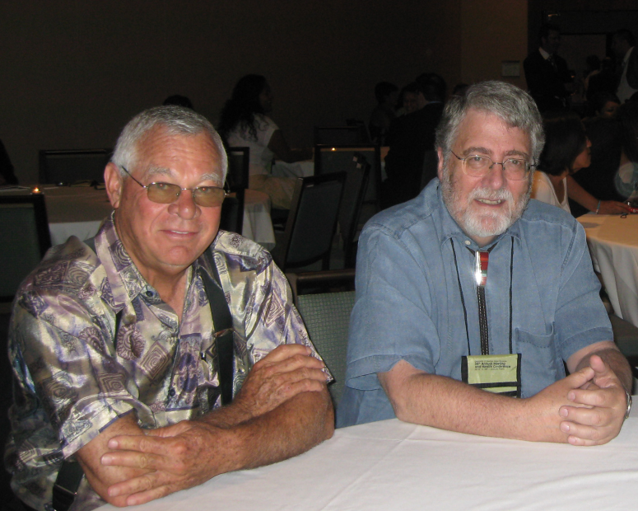
Future Plans
Recruit new mentees each year
Further refine the mentor role and recruit new mentors
Recruit new senior non-Native researchers as associates
Continue to develop relationships with the IHS and professional health organizations
Continue to develop a National University Consortium for Native Health Research
Apply for National Mentoring Network Grant

Slide 18
Contact us at
503.494.3703
E-mail
Dale Walker, MD
onesky@ohsu.edu
Or visit our website:
www.oneskycenter.org

Slide 19
Mentee Successes
1 New Faculty appointment
4 Graduates (2-PhD, 1 DO, 1 MPH)
3 Admissions (2- MPH, 1- PhD)
2 Grad School Applicants (1 - MPH, 1- MD)
1 Funded Grant
Numerous Publications & Presentations
3 Grants in Preparation
2 Post – Doc Fellows
2 On-going Research Projects (Funded)
National Leadership Roles
Post-Doc Fellowship Explorations
“Waiting List” of identified graduate students
Annual Conference & Focused Workshop

Slide 20
Mentor Successes
      University Collaborative
      National Native Faculty
      2 Faculty Promotions
      Numerous Presentations
      National Leadership Positions
      Major awards for service related to training
      Expanded Expertise (Biological, Genetic)
      Website
      Student & Faculty Recruitment to Mentorship program

