Slide 1
Understanding Native Health and Health Disparities: Social Determinants
One Sky Center
Oregon Health and Science University
R Dale Walker, MD Patricia Silk Walker, PhD Michelle Singer
Harvard University Native American Program
Boston, Massachusetts
April 18, 2011
Notes:
ABSTRACT: The health status for American Indian and Alaskan Natives is well documented to be far below that of the general population of the United States. The morbidity and mortality for chronic illnesses in this special population is especially recognized as problematic. Behavioral health problems such as depression, anxiety, addictions, suicide, and family disruption are all seen as health concerns when examined across all tribes. The ability to provide access to adequate, culturally sensitive, evidence based care in this era of health reform and economic crisis is especially challenging.
World-wide, the most recognized approach to address these issues is the public health movement with special attention to social determinates of health.
Social determinants are defined as how and where we live, learn, work and play through our life This presentation reviews the chronic illness issues of Native populations and examines how social determinants can assist in rethinking health care delivery in Native communities.

Slide 2
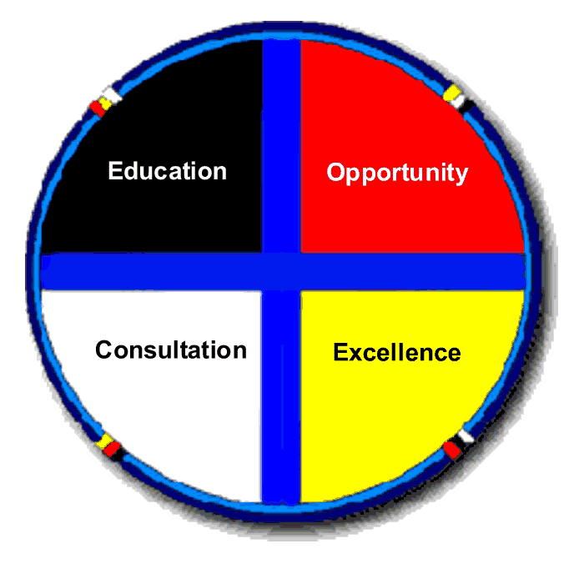
Native Communities
Advisory Council / Steering Committee
Education
Opportunity, Research
Mentorship
One Sky Center
Training,
Consultation,
Technical
Assistance
Excellence
Tribal
Leadership

Slide 3
Goals for Today
Where and who are the Native US Peoples?
Discuss Finances and Fragmentation of Services
Present Some Health Care Issues
Describe Social Determinants of Health
Present Native Mentorship Model

Slide 4
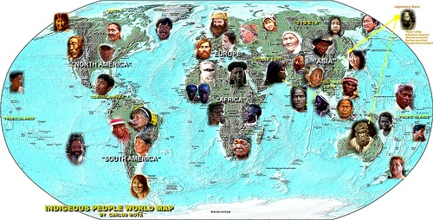
Who are indigenous peoples?
“Indigenous peoples remain on the margins of society: they are poorer, less educated, die at a younger age, are much more likely to commit suicide, and are generally in worse health than the rest of the population."
(Source: The Indigenous World 2006, International Working Group on Indigenous Affairs (IWGIA) WHO

Slide 5
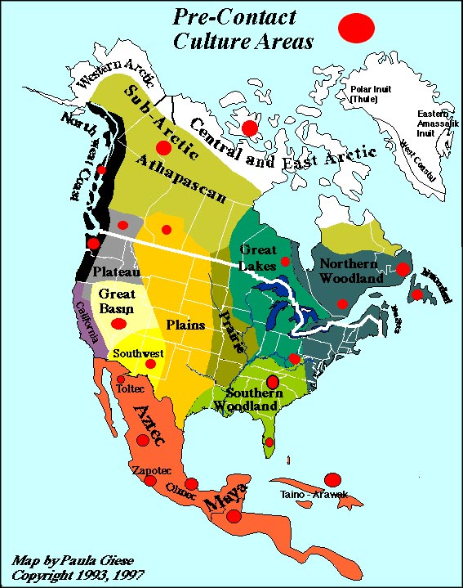

Slide 6
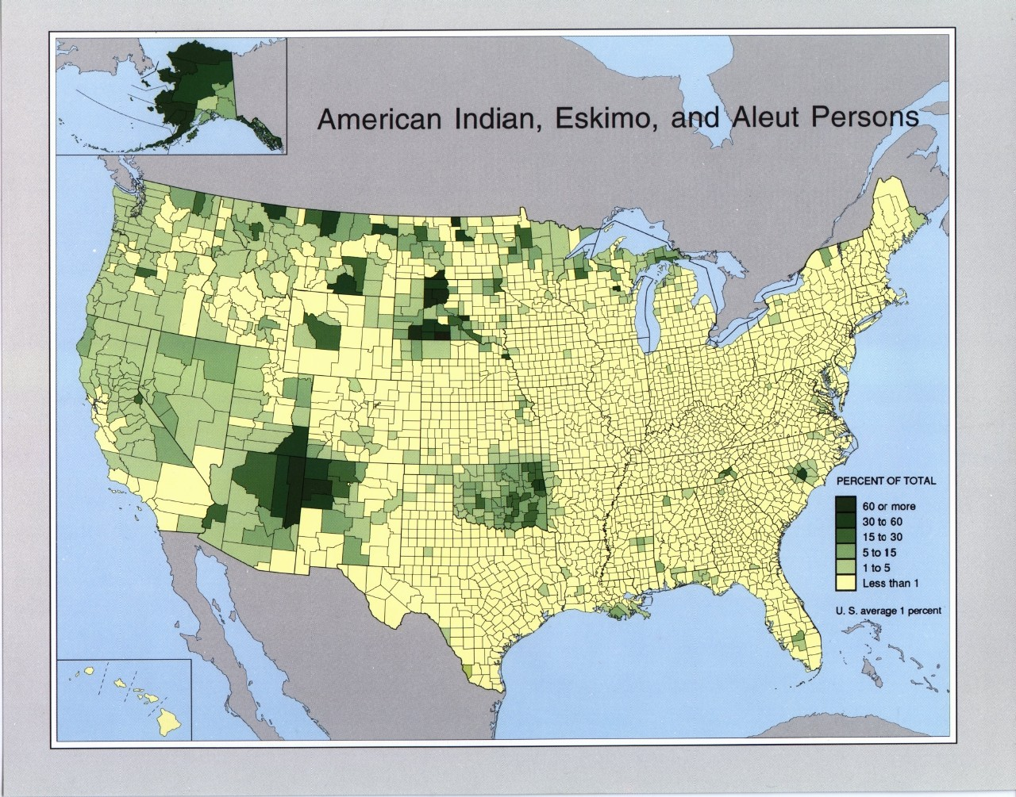

Slide 7
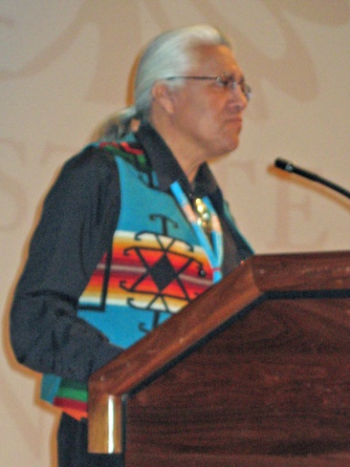
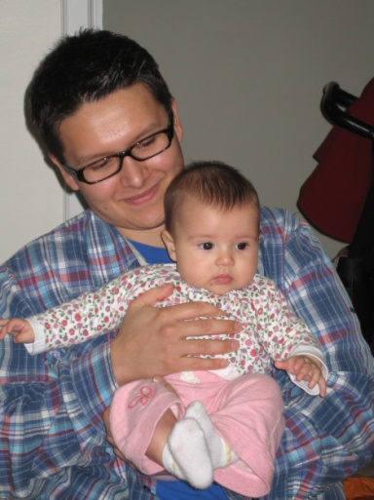
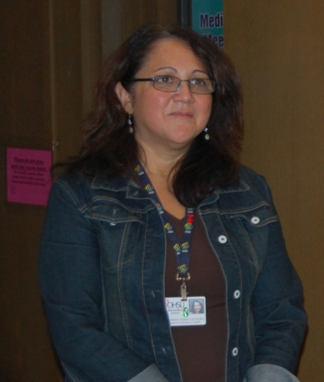
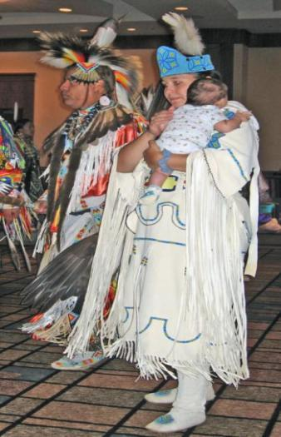
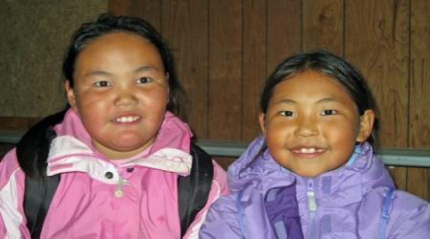
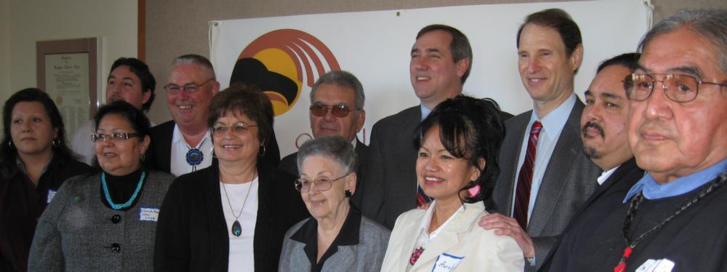

Slide 8
Native Healthcare Resource Disparities

Slide 9
Agencies Involved in B.H. Delivery
1. Indian Health Service (IHS)
A. Mental Health
B. Primary Health
C. Alcoholism / Substance Abuse
2. Bureau of Indian Affairs (BIA)
A. Education
B. Vocational
C. Social Services
D. Police
3. Tribal Health
4. Urban Indian Health
State and Local Agencies
Federal Agencies: SAMHSA, VAMC, Justice

Slide 10
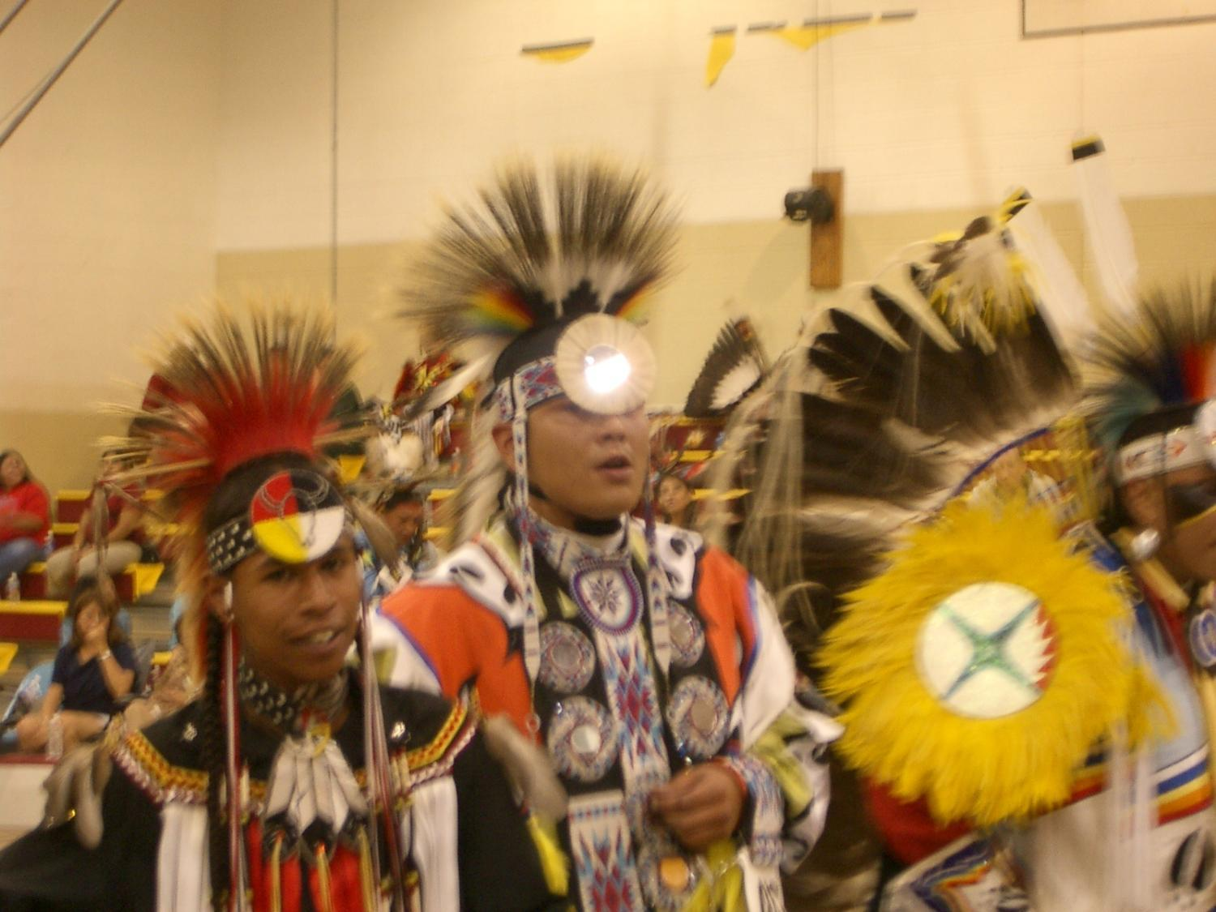
Behavioral Health Care Issues

Slide 11
Native Health Issues
Alcoholism 6X
Tuberculosis 6X
Diabetes 3.5 X
Accidents 3X
Poverty 3x
Depression 3x
Suicide 2x
Violence?
Same disorders as general population
Greater prevalence
Greater severity
Much less access to Tx
Cultural relevance more challenging
Social context disintegrated

Slide 12
Suicide Among ages 15-17, 2001
Death rate per 100,000
2010
Target
0
Total
American
Indian
Black
White
Females
Males
Asian
Hispanic
Source: National Vital Statistics System - Mortality, NCHS, CDC.

Slide 13
Disease Burden by Illness – DALY High Income Countries - All Ages – 2004
0 2 4 6 8 10
15.2%
DALY = Disability-Adjusted Life Year (measures healthy life years loss to premature death and disability)
Source: World Health Organization – Burden of Disease Statistics, 2004

Slide 14
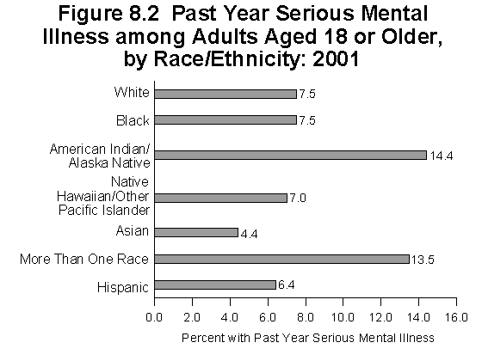
Adult Serious Mental Illness
By Race/Ethnicity: 2001
SAMHSA Office of Applied Studies, 2001

Slide 15
Mental Illness: A Multi-factorial Event
Racism
Psychiatric Illness & Stigma
Opportunity
Cultural Distress
Edu., Econ., Rec.
Impulsiveness
Substance Use/Abuse
Hopelessness
Family Disruption/
Domestic Violence
Individual
Family History
Negative Boarding School
Psychodynamics/
Psychological Vulnerability
Historical Trauma
Suicidal
Behavior
Notes:
racism

Slide 16
Specific Native Scientist Disparity Concerns
>50% Native Americans entering as college freshman will leave after their first year.
Native American retention rate is 15% below the national average.
About 20 will enter college and only 3 will graduate with a four-year degree
Source: National Institute for Native Leadership in Higher Education, 2002
Major Shortage of American Indian Health Professionals

Slide 18
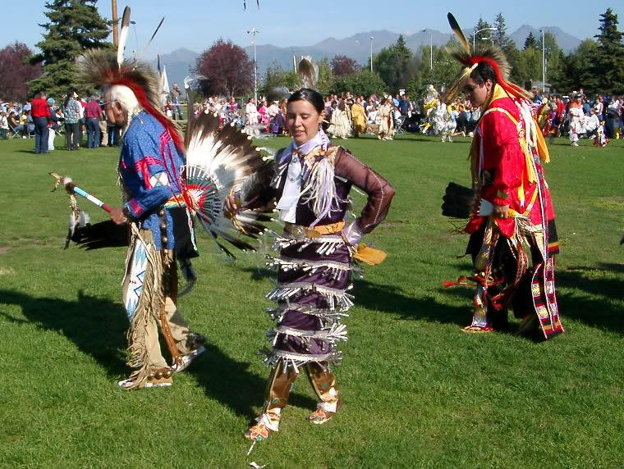
Models of Care

Slide 19
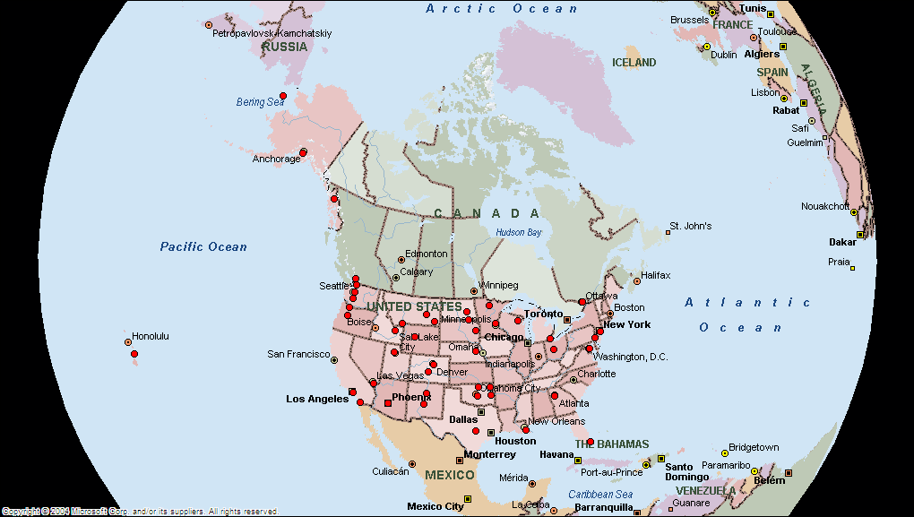
One Sky Center Outreach

Slide 20
Culture Values
Philosophies
Belief about causes of problems and solutions
Local innovation, trial and error
Medicinal use of wild plants and minerals
Healing procedures
Oral transmission of knowledge
Community evaluation and acceptance
Practice (Service)
Best Practice
Science & Scholarship
Notes:
Culture is a body of knowledge which includes:
Philosophies
Belief about causes of problems and solutions
Local innovation, trial and error
Medicinal use of wild plants and minerals
Healing procedures
Oral transmission of knowledge
Community evaluation and acceptance of practices/programs

Slide 21
Community Based Logic Model
1. Causes
Goals
2.
Target Population
Intervention
Outcomes
8. Long term (Impact)
7. Medium term
6. Short term
5. Operations Manual
4. Theory of Change
3. Strategy
Notes:
Now we go from the big, strategic planning picture to a detailed description of the program
I’ll step through each box in this model in turn, as shown in the numbers 1 -8

Slide 22
Spectrum of Intervention Responses
Thresholds for Action
No Problems
Mild Problems
Moderate Problems
Severe Problems
Treatment
Brief Intervention
Universal/Selective Prevention
Notes:
TRAINER:
Explain that it is possible to match individual students to treatment approaches in ways that increase the probability of treatment effectiveness and efficiency and that BASICS as a brief intervention is also appropriately described as “indicated” prevention
Speaking Points:
“Treatment matching” is based on the notion that a spectrum of alcohol consumption and related problems exists, that no single treatment approach is effective in treating all persons with alcohol problems, and that different programs may be optimal for different types of people.
Indicated interventions are those that focus on individual students who already drink heavily and have experienced, or are at risk of experiencing, alcohol-related problems at the “Threshold for Action” on the graphic.
Brief interventions are one type of indicated intervention.

Slide 23
Domains Influencing Behavioral Health: A Native Ecological Model
Risk
Individual
Peers/Family
Community/Tribe
Society/Cultural
Protection

Slide 24
Effective Interventions for Adults
Cognitive/Behavioral Approaches
Motivational Interventions
Psychopharmacological Interventions
Modified Therapeutic Communities
Assertive Community Treatment
Vocational Services
Dual Recovery/Self-Help Programs
Consumer Involvement
Therapeutic Relationships

Slide 25
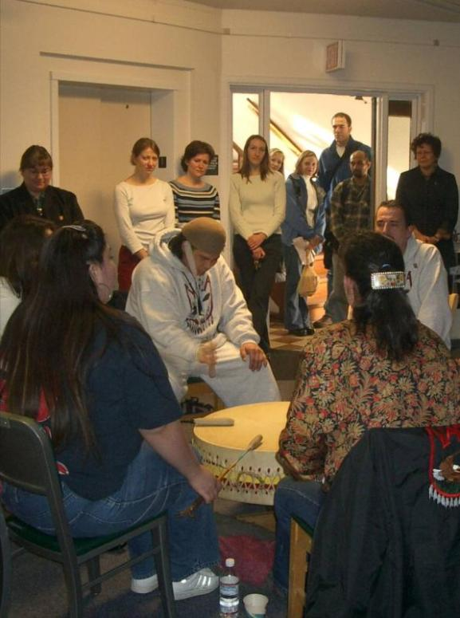
Culture-Based Interventions
Story telling
Sweat Lodge
Talking circle
Vision quest
Wiping of tears
Drumming
Smudging
Traditional Healers
Herbal remedies
Traditional activities

Slide 26
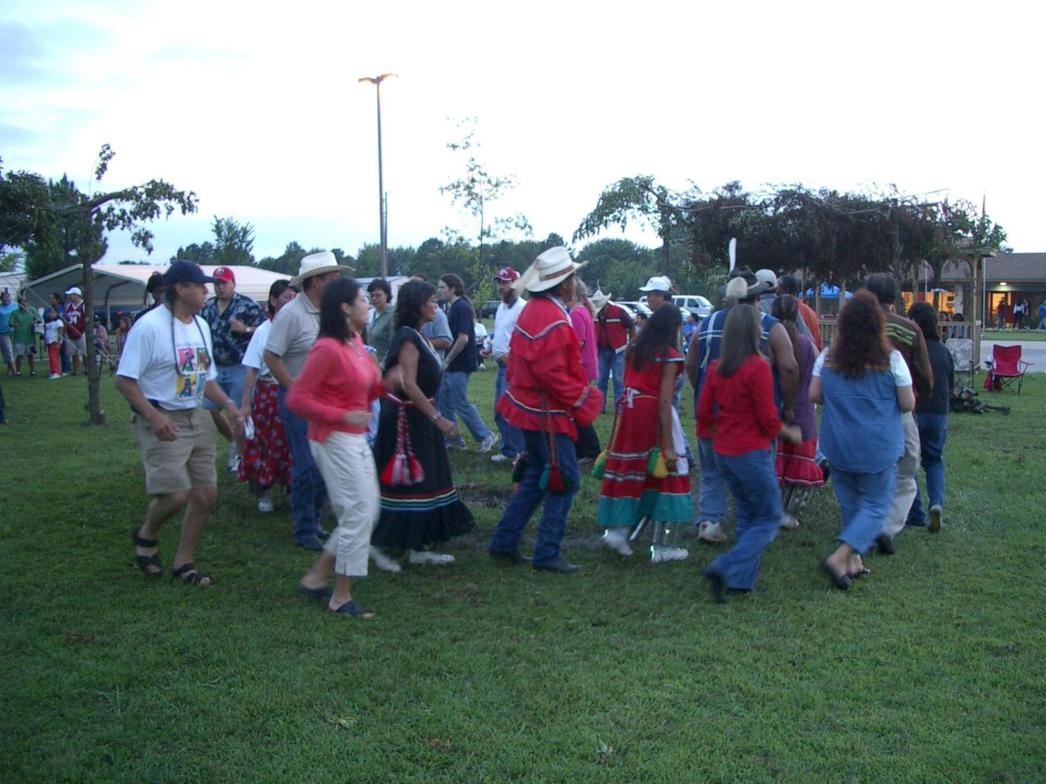
What are some promising strategies?

Slide 27
Social Determinates of Health: Whitehall Studies
Within a hierarchical society, there is a social gradient for morbidity and mortality. (Poverty, sanitation, nutrition, and shelter are controlled.)
Higher status folks live longer and healthier.
Health Care Improvement Needs More Than Money:
Opportunity, Empowerment, Security, Control, and Dignity….
www.thelancet.com Dec 9, 2006. Michael Marmot
Amartya Sen 1998 Nicholas Stern 2004
Notes:
Poverty exists if you can’t do what is reasonable to expect in society.
Nicholas Stern is Head of the Government Economic Service and Second Permanent Secretary to the Treasury of the United Kingdom. He served as Chief Economist and Senior Vice President at the World Bank from July 2000 to October 2003, and before that held academic positions at institutions including the London School of Economics, Oxford University, and MIT.
Growth and Empowerment Making Development Happen Nicholas Stern, Jean-Jacques Dethier and F. Halsey Rogers Paper / September 2006 The former Chief Economist at the World Bank proposes a strategy for development based on two interrelated approaches: building an investment climate that encourages growth and empowering poor people to participate in that growth.
Sen's papers in the late 1960s and early 1970s helped develop the theory of social choice, which first came to prominence in the work by the American economist Kenneth Arrow, who, while working at the RAND Corporation, famously proved that all voting rules, be they majority rule or two thirds-majority or status quo, must inevitably conflict with some basic democratic norm. Sen's contribution to the literature was to show under what conditions Arrow's impossibility theorem would indeed come to pass as well as to extend and enrich the theory of social choice, informed by his interests in history of economic thought and philosophy.
Welfare economics seeks to evaluate economic policies in terms of their effects on the well-being of the community. Sen, who devoted his career to such issues, was called the "conscience of his profession." His influential monograph Collective Choice and Social Welfare (1970), which addressed problems related to individual rights (including formulation of the liberal paradox), justice and equity, majority rule, and the availability of information about individual conditions, inspired researchers to turn their attention to issues of basic welfare. Sen devised methods of measuring poverty that yielded useful information for improving economic conditions for the poor.

Slide 28
.
Socio-
economic
Socio-cultural
Science
&
Technology
Biological
Health
Aging
Behavioral
Education
Gender
Environmental
Social
Justice
Human
Rights

Slide 29
Role of Inequities in Healthcare
Adapted from V. Hogan

Slide 30
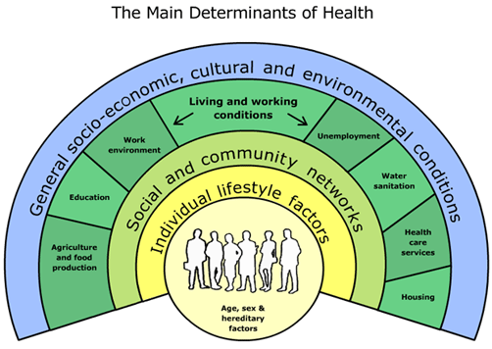
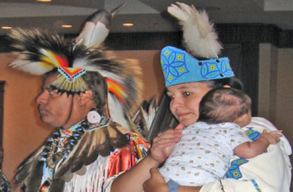
The Social Determinants of Health
The conditions in which people are born, grow, live, work and age.
Shaped by the distribution of money, power and resources at global, national and local levels.
Are mostly responsible for health inequities - the unfair and avoidable differences in health status seen within and between countries.
WHO Commission on Social Determinants of Health | August 28 2008

Slide 31
Conceptual Framework of Health Determinants

Slide 32
Critical Elements for Native Peoples
Self determination
Ecology and environment
Economic prosperity, fairness and equity
Leadership and capacity strengthening
Racism / dominance / imperialism
Healing, services, systems, structures
Cultural sustainability, protection, stewardship
Land
Human rights

Slide 33
Areas for Action
Health Equity in all Policies
Fair Financing
Good
Governance
Early child development and education
Healthy Places
Fair Employment
Social Protection
Universal Health Care
Responsibility
Gender Equity
Political empowerment
– inclusion and voice

Slide 34
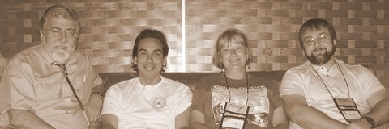
Native-to-Native Mentorship: An Element of the Solution to Native Health Disparities
Understanding Native American Health and Health Disparities Boston, Massachusetts
April 18, 2011
Notes:
34

Slide 35
Why Develop a Native Mentoring Program?
Provide instruction on conducting research
Provide insight into Native identity – Personal and Community
Improve trainee's self-confidence
Critique and support trainee's research
Assist in defining and achieving career goals
Socialize trainee into the profession
Assist in development of collegial networks
Advise how to balance work and personal life
Assist in the development of future colleagues
Notes:
There are the recognized reasons to provide mentorship, but there is also risk and protection, the burdens of illness and social determinants

Slide 36
NIDA Goals
Increase and retain underrepresented minority investigators (American Indian, Alaska Native and Native Hawaiian) who conduct substance abuse and addiction research
Establish effective communication pathways for recruitment of new investigators or candidates for training positions at NIDA
Notes:
NIDA Workgroup Goals

Slide 37
Native Workgroup Goals
Education of public, students, health practitioners and researchers on addiction in the AI/AN/NH population as well as associated co-morbidities
Enhance research competency
Develop research concepts
Advocate for the grant application process
Understand and maintain Native community based research
Mentoring of Native students and early career faculty

Slide 38
Native Mentorship Goals
Mentor and train American Indian students and early career faculty interested in substance abuse and addictions research
Pair Mentees with Mentors and encourage training, site visits, and professional development
Assist in identification and recruitment of candidates for NIDA training opportunities
Maintain a website at www.oneskycenter.org to identify Mentors, Mentees, faculty/student interests and projects, and NIDA agenda.
Enhance Native community awareness and involvement
Attend and participate in National Scientific Conferences that focus on American Indian Health and/or addictions research

Slide 39
NIDA Native Mentorship
Mentors: 17
Mentees: 21

Slide 40
The 5 Elements of Mentoring Program
Recruit: Define eligibility, market program, conduct information sessions
Screen: applications, reference checks, interviews, orientation
Train: Overview of the program, role clarification, situational “how-to’s”
Match: Establish criteria, ensure all parties understand and agree to the terms and conditions of participation
Monitor: Continuing training opportunities, regular communication, goal setting and achievement, conflict resolution, documentation

Slide 41
Native Mentoring Logic Model
Predoctoral
Doctoral
Postdoctoral
Junior Mentor
Senior Mentor
Interactive Mentoring Relationships:
A mentee will have a primary mentor and have access to all mentors, mentees, their academic institutions, NIDA and NIAAA

Slide 42
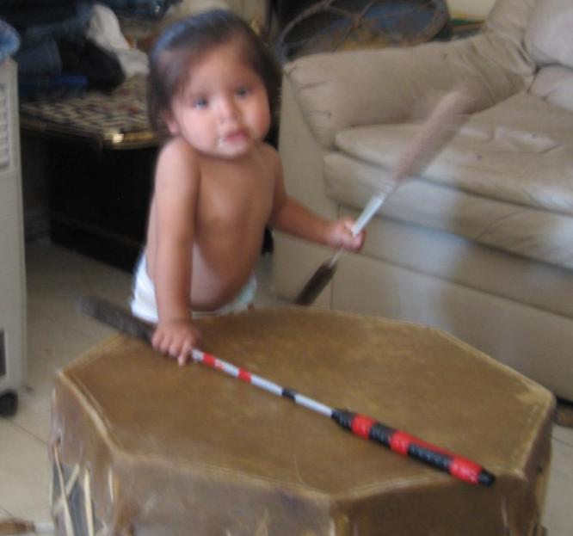
Mentor Responsibilities: Competing ISSUES
Mentoring?
Advising
Community Involvement
Family
Tribal
Spiritual
Advocacy
Teaching Students
Clinical Service
Research
Academic Travel
Grant
Proposals
Personal Time

Slide 43
Mentee Self-assessment
What are my research ambitions?
What are my current research skills and knowledge?
What are some possible research interests I have?
What support do I need to pursue those research interests responsibly?
What do I need to advance my faculty career?
What is the timetable to complete my education/training/promotion?

Slide 44
Types of Mentorship Contact
Face-to-Face
Especially for important and/or confidential issues
Attend conferences as mentor/mentee teams
Discuss career objectives and strategies
Co-present at conferences
Have lunch/break together at meetings
E-mail
Alert mentees to programs and new information
For mentees to ask quick questions, seek direction
Reminders about programs, etc.
Phone
Set up strategy meetings and touch base; conference calls
When confidentiality and voice tone are critical, face-to-face is not practical and email won’t do
Web site
Reference materials, data links,and news
Notes:
Face-to-Face
Especially for important and/or confidential issues
Attend national and regional conferences as mentor/mentee teams
Discuss career objectives and strategies to accomplish those
Co-present at conferences
Have lunch/break together at meetings
E-mail
Alert mentees to programs and new information
For mentees to ask quick questions, seek direction
Reminders about programs, etc.
Phone
Set up strategy meetings and touch base
When confidentiality and voice tone are critical, face-to-face is not practical and email won’t do
Web site
Reference materials, data links and news

Slide 45
Mentorship Activities
Attend scientific conferences with Native researchers and Native/Community themes and policy
Discuss research methods tailored to individual needs
A. Questions, design, statistics, ethics
B. Methods in community based research
3. Discuss grant applications and management
A. Writing proposals, find funding, career
development, writing papers, networking
B. Budgeting time, effort, and funds
C. Mock NIMH review sessions
4. Develop Mentee-needs specific Workshops

Slide 46
Mentorship: Areas for Discussion
Culture, politics, and identity
How to set special research plans (short and long)
Schedule for submitting articles and grant proposals
The publication process
Course planning, teaching strategies, mentoring students
Departmental relations
Time management and professional/personal balance
Tenure and promotion process and expectations
Substantive, theoretical and methodological interests

Slide 47
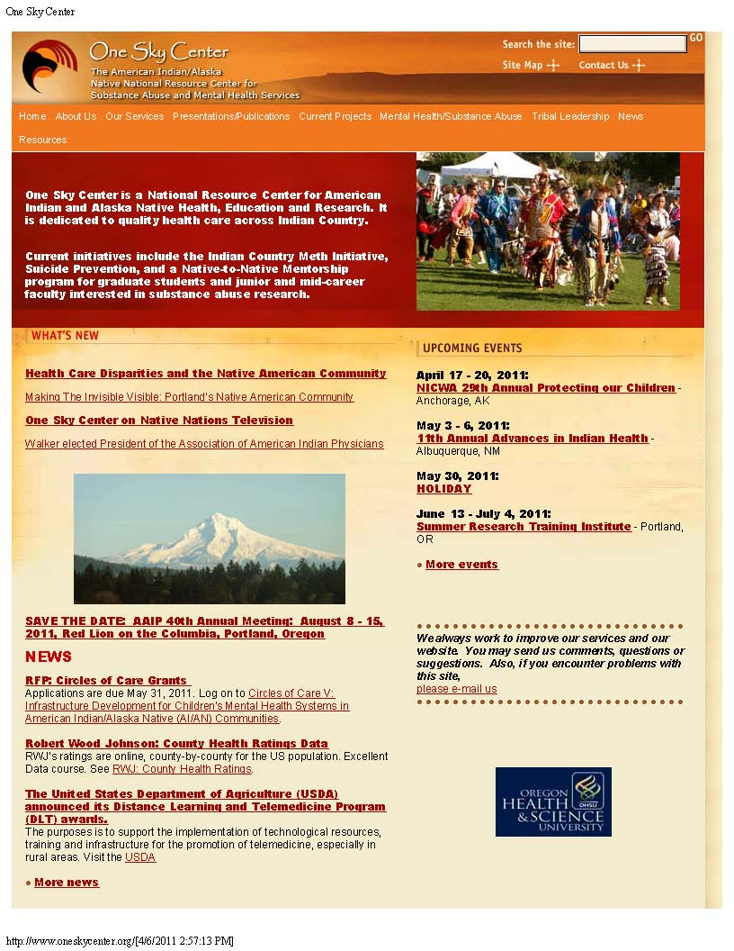
Current Projects
NIDA Mentorship
Introduction
Mentors and Staff
Mentees
News, Recruitment, Links

Slide 48
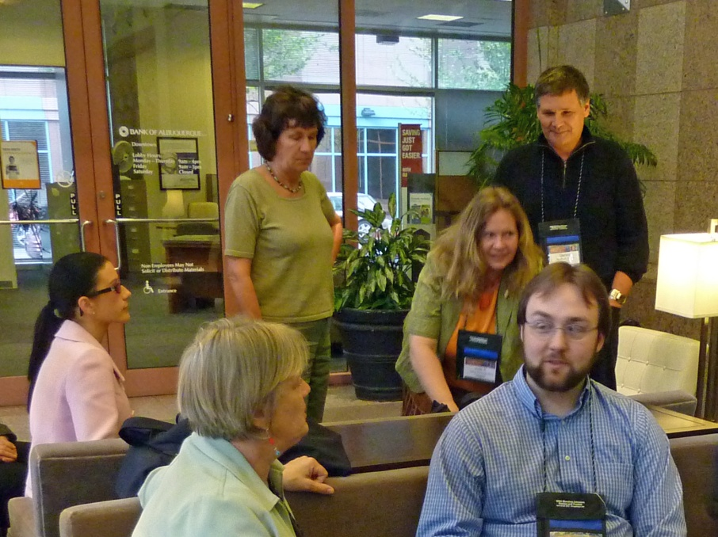
Mentees

Slide 49
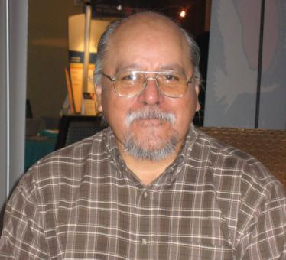
Future Plans
Recruit new mentees each year
Further refine the mentor role and recruit new mentors
Recruit new senior non-Native researchers as Associates
Continue to develop relationships with the IHS and professional health organizations
Continue to develop a National University Consortium for Native Health Research
Apply for National Mentoring Network Grant

Slide 50
Attend 40th Annual Conference of The Association of American Indian Physicians (AAIP)
“Shared Visions: Blending Tradition, Culture, and Health Care for Our Native Communities”
Mentorship focused Workshop
Attend Scientific Sessions of AAIP conference
Primarily American Indian presenters and attendees
National leaders in Native research
Conference sessions debriefed daily vis-à-vis academic and scientific career goals
Networking and relationship building
Portland, Oregon, August 9-14, 2011

Slide 51
Agenda for Mentorship Group
Participate in a Mentorship Specific Workshop
Participate in AAIP meeting
Attend scientific sessions, organized activities and community activities
Meet throughout the conference with mentors, mentees, and others
Goal 1: Learn and advance mentee-mentor personal goals and directions
Goal 2: Search for potential students and mentors
Goal 3: Experience a large Native/Scientific meeting with Federal officials, advisors

Slide 52
Contact us at
503.494.3703
E-mail
Dale Walker, MD
onesky@ohsu.edu
Or visit our website:
www.oneskycenter.org

