Slide 1
Understanding Native Health Equity: A Social Determinants Approach
One Sky Center
Oregon Health and Science University
R Dale Walker, MD Patricia Silk Walker, PhD Michelle Singer
Health Equity Leadership Institute New York, New York
April 2, 2011
Notes:
ABSTRACT: The health status for American Indian and Alaskan Natives is well documented to be far below that of the general population of the United States. The morbidity and mortality for chronic illnesses in this special population is especially recognized as problematic. Behavioral health problems such as depression, anxiety, addictions, suicide, and family disruption are all seen as health concerns when examined across all tribes. The ability to provide access to adequate, culturally sensitive, evidence based care in this era of health reform and economic crisis is especially challenging.
World-wide, the most recognized approach to address these issues is the public health movement with special attention to social determinates of health.
Social determinants are defined as how and where we live, learn, work and play through our life This presentation reviews the chronic illness issues of Native populations and examines how social determinants can assist in rethinking health care delivery in Native communities.

Slide 2
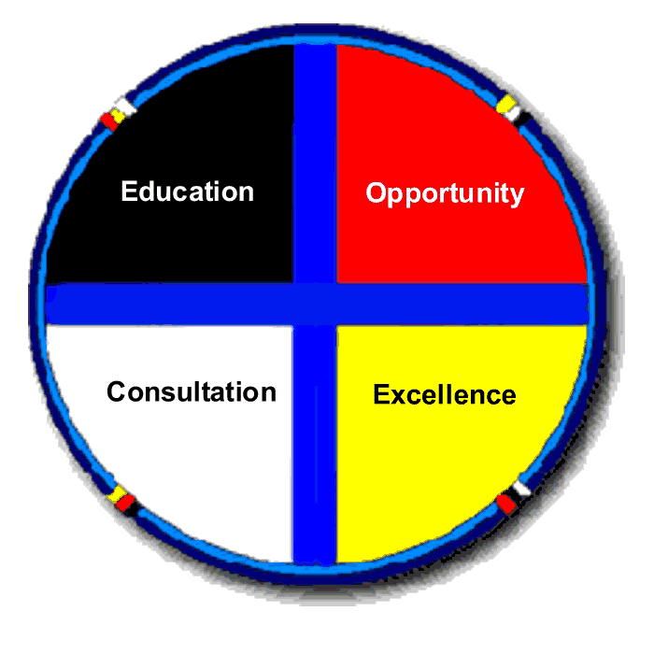
Native Communities
Advisory Council / Steering Committee
Education
Opportunity, Research
Mentorship
One Sky Center
Training,
Consultation,
Technical
Assistance
Excellence
Tribal
Leadership

Slide 3
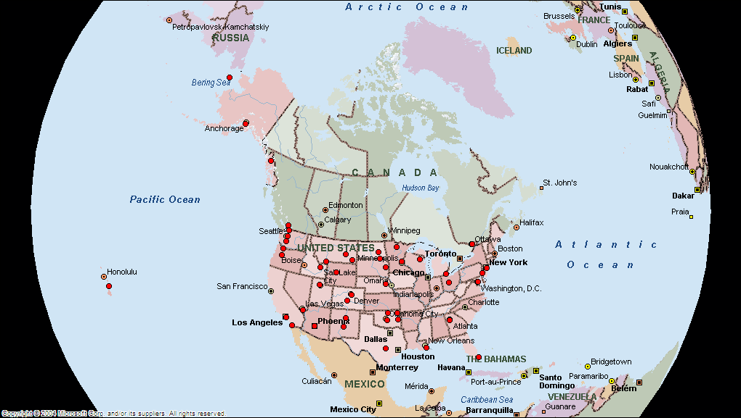
One Sky Center Outreach

Slide 4
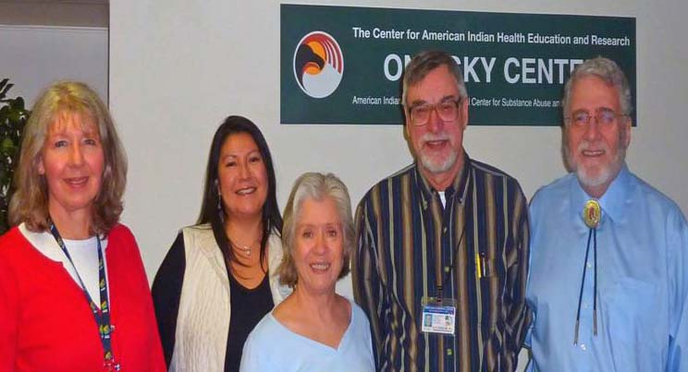
One Sky Center Staff
Susan Michelle Patricia Doug Dale

Slide 5
Goals for Today
Review An Environmental Scan for Natives
Discuss Fragmentation and Integration
Present Some Health Care Issues
Define Social Determinants of Health
Present Examples of Treatment and Prevention
Summarize Critical Issues for Native Peoples

Slide 6
Who are indigenous peoples?
“Indigenous peoples remain on the margins of society: they are poorer, less educated, die at a younger age, are much more likely to commit suicide, and are generally in worse health than the rest of the population."
(Source: The Indigenous World 2006, International Working Group on Indigenous Affairs (IWGIA) WHO

Slide 7
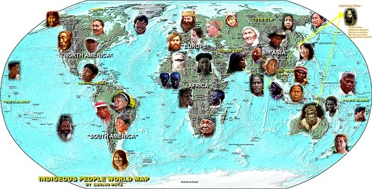
INDIGENOUS PEOPLE WORLD MAP - 370 million indigenous peoples living in more than 70 countries

Slide 8
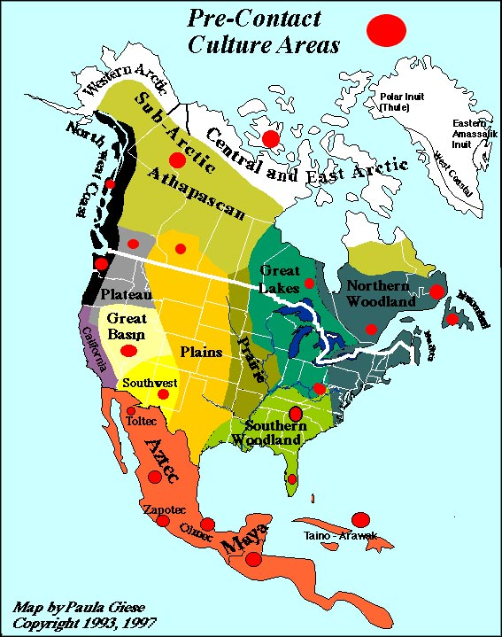

Slide 10
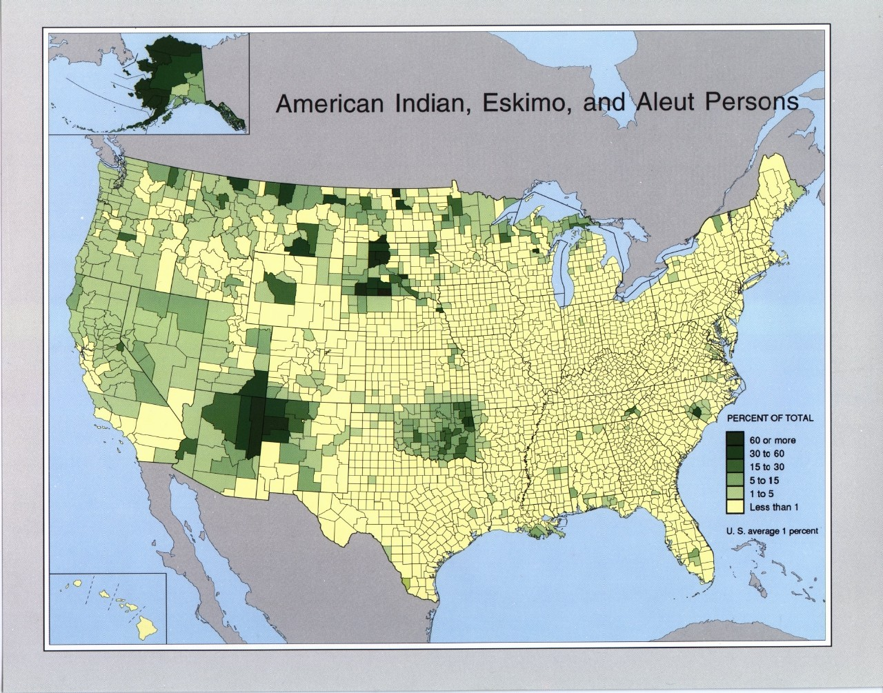

Slide 11
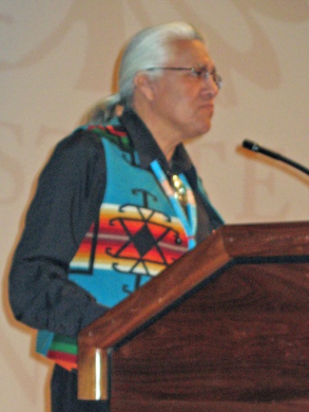
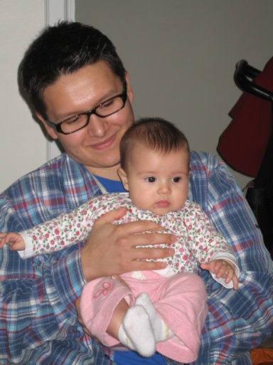
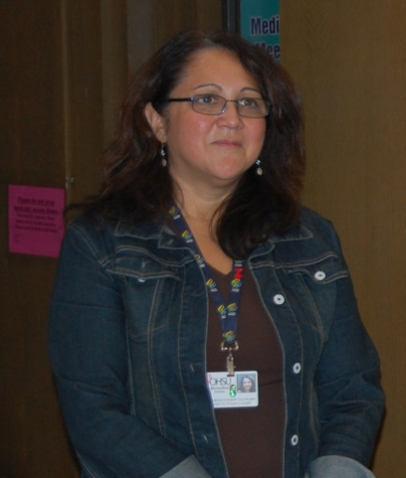
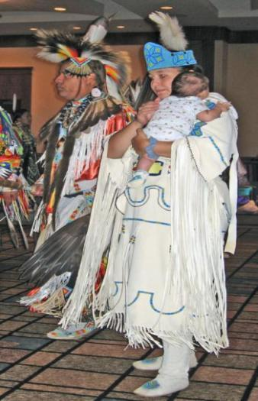
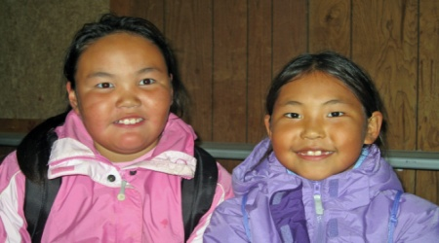
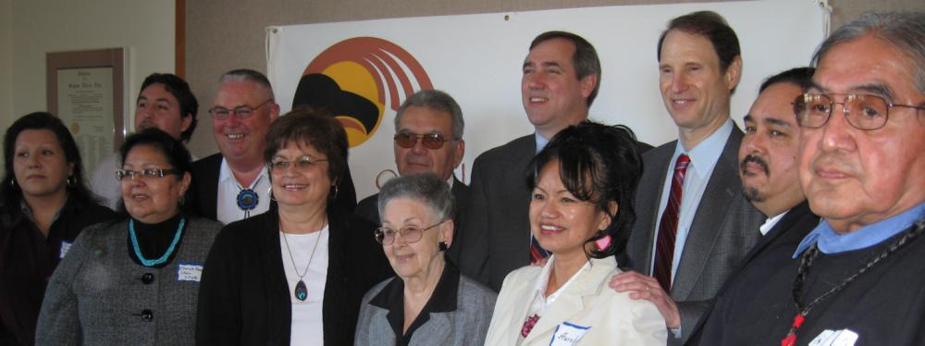

Slide 12
Native Healthcare Resource Disparities

Slide 13
Agencies Involved in B.H. Delivery
1. Indian Health Service (IHS)
A. Mental Health
B. Primary Health
C. Alcoholism / Substance Abuse
2. Bureau of Indian Affairs (BIA)
A. Education
B. Vocational
C. Social Services
D. Police
3. Tribal Health
4. Urban Indian Health
State and Local Agencies
Federal Agencies: SAMHSA, VAMC, Justice

Slide 14
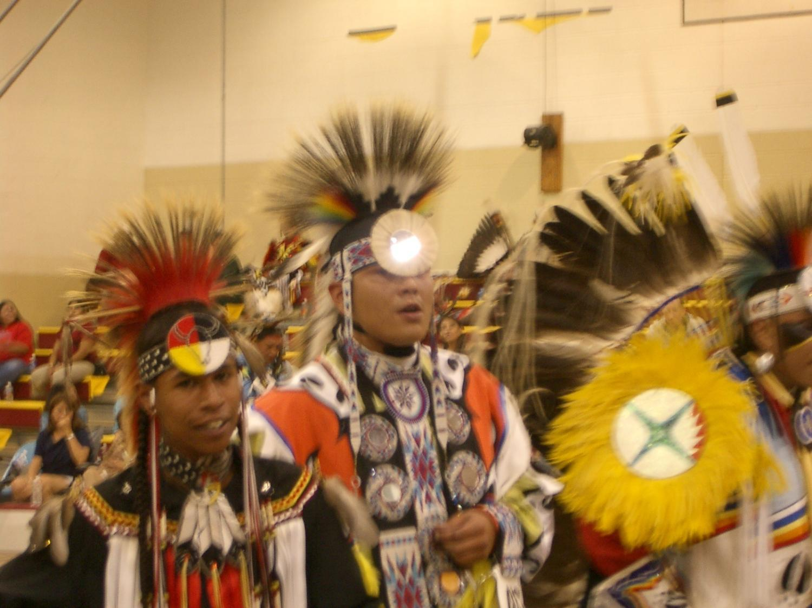
Behavioral Health Care Issues

Slide 15
Native Health Issues
Alcoholism 6X
Tuberculosis 6X
Diabetes 3.5 X
Accidents 3X
Poverty 3x
Depression 3x
Suicide 2x
Violence?
Same disorders as general population
Greater prevalence
Greater severity
Much less access to Tx
Cultural relevance more challenging
Social context disintegrated

Slide 16
Disease Burden by Illness – DALY High Income Countries - All Ages – 2004
0 2 4 6 8 10
15.2%
DALY = Disability-Adjusted Life Year (measures healthy life years loss to premature death and disability)
Source: World Health Organization – Burden of Disease Statistics, 2004

Slide 17
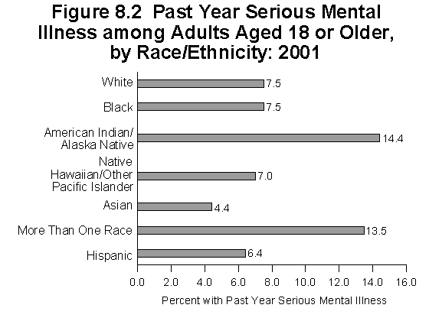
Adult Serious Mental Illness
By Race/Ethnicity: 2001
SAMHSA Office of Applied Studies, 2001

Slide 18
Mental Illness: A Multi-factorial Event
Psychiatric Illness & Stigma
Cultural Distress
Edu., Econ., Rec.
Impulsiveness
Substance Use/Abuse
Hopelessness
Family Disruption/
Domestic Violence
Individual
Family History
Negative Boarding School
Psychodynamics/
Psychological Vulnerability
Historical Trauma
Suicidal
Behavior

Slide 19
Suicide Among ages 15-17, 2001
Death rate per 100,000
2010
Target
0
Total
American
Indian
Black
White
Females
Males
Asian
Hispanic
Source: National Vital Statistics System - Mortality, NCHS, CDC.

Slide 20
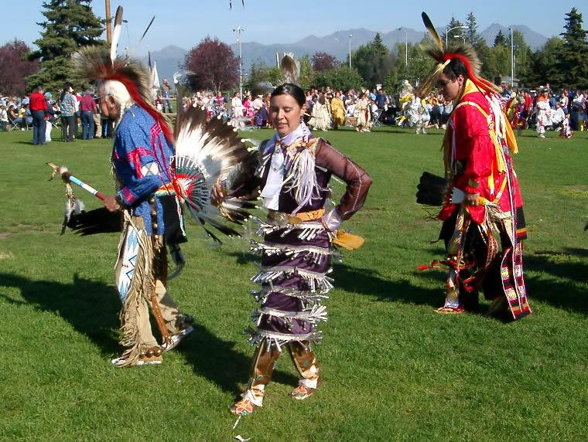
Models of Care

Slide 21
Practice (Service)
Culture Values
Philosophies
Belief about causes of problems and solutions
Local innovation, trial and error
Medicinal use of wild plants and minerals
Healing procedures
Oral transmission of knowledge
Community evaluation and acceptance
Best Practice
Science & Scholarship
Notes:
Culture is a body of knowledge which includes:
Philosophies
Belief about causes of problems and solutions
Local innovation, trial and error
Medicinal use of wild plants and minerals
Healing procedures
Oral transmission of knowledge
Community evaluation and acceptance of practices/programs

Slide 22
Logic Model
1. Causes
Goals
2.
Target Population
Intervention
Outcomes
8. Long term (Impact)
7. Medium term
6. Short term
5. Operations Manual
4. Theory of Change
3. Strategy
Notes:
Now we go from the big, strategic planning picture to a detailed description of the program
I’ll step through each box in this model in turn, as shown in the numbers 1 -8

Slide 23
Spectrum of Intervention Responses
Thresholds for Action
No Problems
Mild Problems
Moderate Problems
Severe Problems
Treatment
Brief Intervention
Universal/Selective Prevention
Notes:
TRAINER:
Explain that it is possible to match individual students to treatment approaches in ways that increase the probability of treatment effectiveness and efficiency and that BASICS as a brief intervention is also appropriately described as “indicated” prevention
Speaking Points:
“Treatment matching” is based on the notion that a spectrum of alcohol consumption and related problems exists, that no single treatment approach is effective in treating all persons with alcohol problems, and that different programs may be optimal for different types of people.
Indicated interventions are those that focus on individual students who already drink heavily and have experienced, or are at risk of experiencing, alcohol-related problems at the “Threshold for Action” on the graphic.
Brief interventions are one type of indicated intervention.

Slide 24
Domains Influencing Behavioral Health: A Native Ecological Model
Risk
Individual
Peers/Family
Community/Tribe
Society/Cultural
Protection

Slide 25
Risk and Protective Factors: Individual
Risk
Mental illness
Age/gender
Substance abuse
Loss
Previous suicide attempt
Personality traits
Incarceration
Failure/academic problems
Protective
Cultural/religious beliefs
Coping/problem solving skills
Ongoing health and mental health care
Resiliency, self esteem, direction, mission, determination, perseverance, optimism, empathy
Intellectual competence, reasons for living

Slide 26
Individual Intervention
Identify risk and protective factors
counseling
skill building
improve coping
support groups
Increase community awareness
Access to hotlines other help resources

Slide 27
Effective Interventions for Adults
Cognitive/Behavioral Approaches
Motivational Interventions
Psychopharmacological Interventions
Modified Therapeutic Communities
Assertive Community Treatment
Vocational Services
Dual Recovery/Self-Help Programs
Consumer Involvement
Therapeutic Relationships

Slide 28
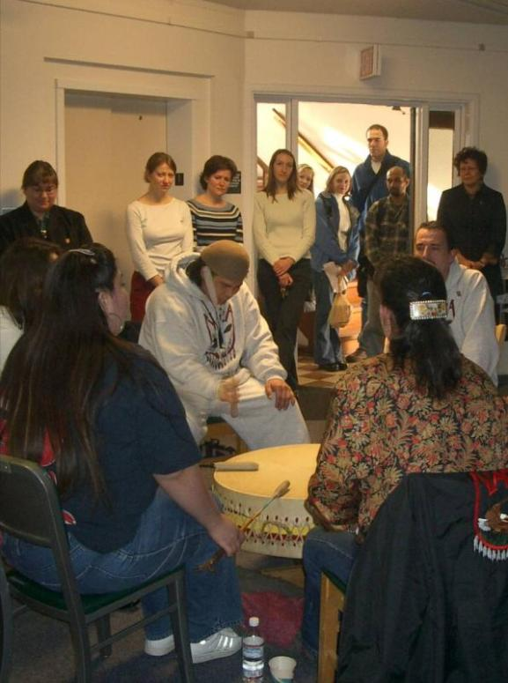
Culture-Based Interventions
Story telling
Sweat Lodge
Talking circle
Vision quest
Wiping of tears
Drumming
Smudging
Traditional Healers
Herbal remedies
Traditional activities

Slide 29
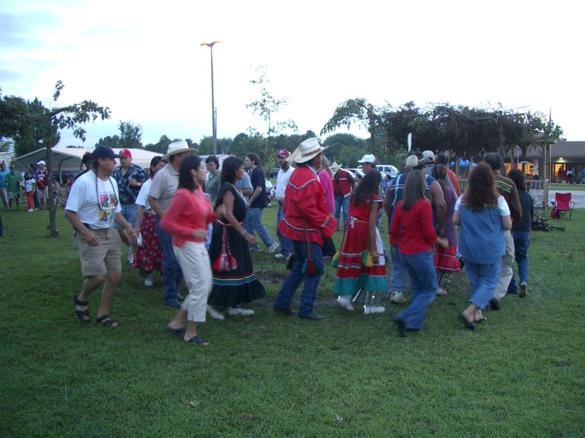
What are some promising strategies?

Slide 30
Social Determinates of Health: Whitehall Studies
Within a hierarchical society, there is a social gradient for morbidity and mortality. (Poverty, sanitation, nutrition, and shelter are controlled.)
Higher status folks live longer and healthier.
Health Care Improvement Needs More Than Money:
Opportunity, Empowerment, Security, Control, and Dignity….
www.thelancet.com Dec 9, 2006. Marmot
Amartya Sen 1998 Nicholas Stern 2004
Notes:
Poverty exists if you can’t do what is reasonable to expect in society.
Nicholas Stern is Head of the Government Economic Service and Second Permanent Secretary to the Treasury of the United Kingdom. He served as Chief Economist and Senior Vice President at the World Bank from July 2000 to October 2003, and before that held academic positions at institutions including the London School of Economics, Oxford University, and MIT.
Growth and Empowerment Making Development Happen Nicholas Stern, Jean-Jacques Dethier and F. Halsey Rogers Paper / September 2006 The former Chief Economist at the World Bank proposes a strategy for development based on two interrelated approaches: building an investment climate that encourages growth and empowering poor people to participate in that growth.
Sen's papers in the late 1960s and early 1970s helped develop the theory of social choice, which first came to prominence in the work by the American economist Kenneth Arrow, who, while working at the RAND Corporation, famously proved that all voting rules, be they majority rule or two thirds-majority or status quo, must inevitably conflict with some basic democratic norm. Sen's contribution to the literature was to show under what conditions Arrow's impossibility theorem would indeed come to pass as well as to extend and enrich the theory of social choice, informed by his interests in history of economic thought and philosophy.
Welfare economics seeks to evaluate economic policies in terms of their effects on the well-being of the community. Sen, who devoted his career to such issues, was called the "conscience of his profession." His influential monograph Collective Choice and Social Welfare (1970), which addressed problems related to individual rights (including formulation of the liberal paradox), justice and equity, majority rule, and the availability of information about individual conditions, inspired researchers to turn their attention to issues of basic welfare. Sen devised methods of measuring poverty that yielded useful information for improving economic conditions for the poor.

Slide 31
.
Socio-
economic
Socio-cultural
Science
&
Technology
Biological
Health
Aging
Behavioral
Education
Gender
Environmental
Social
Justice
Human
Rights

Slide 32
Role of Inequities in Healthcare
Adapted from V. Hogan

Slide 33
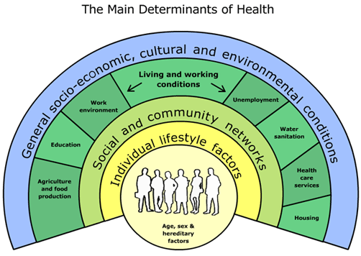
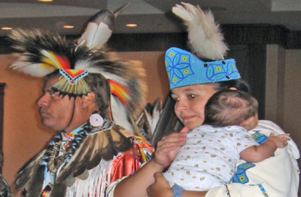
The Social Determinants of Health
The conditions in which people are born, grow, live, work and age.
Shaped by the distribution of money, power and resources at global, national and local levels.
Are mostly responsible for health inequities - the unfair and avoidable differences in health status seen within and between countries.
WHO Commission on Social Determinants of Health | August 28 2008

Slide 34
Conceptual Framework of Health Determinants

Slide 35
Critical Elements for Native Peoples
Self determination
Ecology and environment
Economic prosperity, fairness and equity
Leadership and capacity strengthening
Racism / dominance / imperialism
Healing, services, systems, structures
Cultural sustainability, protection, stewardship
Land
Human rights

Slide 36
Partnered Collaboration
State/Federal
Grassroots Groups
Community-Based
Organizations
Research-Education-Treatment
Notes:
An ideal intervention:
Broadly based:
Includes individual, family,
community, tribe, and society
Comprehensive:
Prevention: Universal, Selective,
Indicated
Treatment
Maintenance
Addresses opportunity, empowerment, security, dignity

Slide 37
Six Key Principles Evidence-based predictors of change
Leadership
Mobilization Community driven
Public health approach
Strength based
Culturally informed
Proactive

Slide 38
The Wharerātā Declaration
1. Indigeneity
2. Best / Wise Practice
3. Best / Wise Evidence
4. Indigenous Leadership
a. Informed d. Connected
b. Creditable e. Sustainable
c. Strategic
5. Indigenous Leadership Influence
http://www.indigenous-mental-health.ca/
Notes:
•Indigeneity encompasses the diversity of indigenous groups and cultures, and the similarities:
–A longstanding and enduring relationship with the natural environment
–A distinctive language
–A world view that is derived from ecological associations
–Experiences that threaten language, land, custom, and social organisation
–A determination to survive and prosper as indigenous peoples –and as global citizens
–An aspiration that indigenous families and communities should have optimal health and wellbeing

Slide 39
Areas for Action
Health Equity in all Policies
Fair Financing
Good
Governance
Early child development and education
Healthy Places
Fair Employment
Social Protection
Universal Health Care
Responsibility
Gender Equity
Political empowerment
– inclusion and voice

Slide 40
Contact us at
503-494-3703
E-mail
Dale Walker, MD
onesky@ohsu.edu
Or visit our website:
www.oneskycenter.org

