Slide 1


The Indian Country Methamphetamine Initiative: Treatment
National Congress of American Indians
Methamphetamine Task Force Meeting
June 1, 2008
Reno, Nevada
Notes:
1

Slide 2
Methamphetamine Identified as the Primary Health/Community Concern
In 2006, Tribal Round Table sessions, HHS Regional Tribal Consultations, and numerous tribal community gatherings with SAMHSA, OMH, and IHS identified Methamphetamine abuse as the primary health concern in Indian Country.

Slide 3
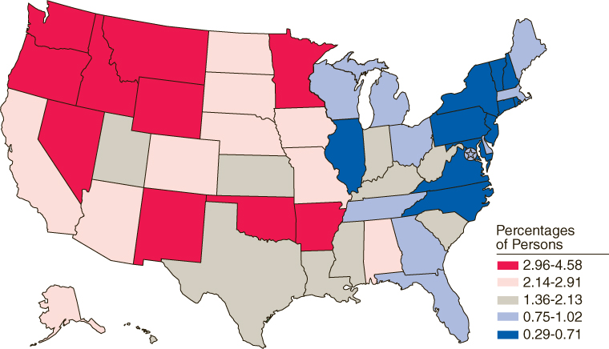
Young Adults Aged 18 to 25 Reporting Past Year Methamphetamine Use: 2002 to 2005
Source: SAMHSA, 2002-2005 .

Slide 4
Methamphetamine: Epidemiology

Slide 5
Why is Methamphetamine so Devastating?
Cheap, readily available
Stimulates, gives intense pleasure
Damages the user’s brain
Paranoid, delusional thoughts
Depression when stop using
Craving overwhelmingly powerful
Brain healing takes up to 2 years
We are not familiar with treating it

Slide 6
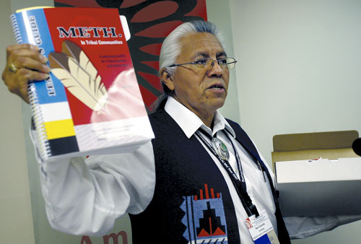
“Tribal leaders unveil new meth Initiative” Indian Country Today
Create a National outreach campaign for all Native communities.
Establish and transfer community based, promising practices for prevention and treatment.
Work across Federal agencies for coordinated and consistent outreach strategy.
NCAI President, Joe Garcia June 15, 2007

Slide 7
ICMI Partners

Slide 8
Tribes Added in Second Year
Chippewa Cree Montana
San Carlos Apache Arizona
Salt River Arizona
Yakama Washington
Welcome!

Slide 9
Clinical Challenges for Treatment of Methamphetamine Addiction
Poor treatment engagement rates
High dropout rates
Severe paranoia
High relapse rates
Ongoing episodes of psychosis
Severe craving
Protracted dysphoria
Many patients may require medical/psychiatric supervision and need ongoing
treatment with antipsychotic medications

Slide 10
What’s Needed?
Gather community based and evidence based treatment efforts for sharing nationwide
Establish training manuals for treatment approaches
Provide a website for distribution
Establish a national training strategy for prevention and treatment

Slide 11
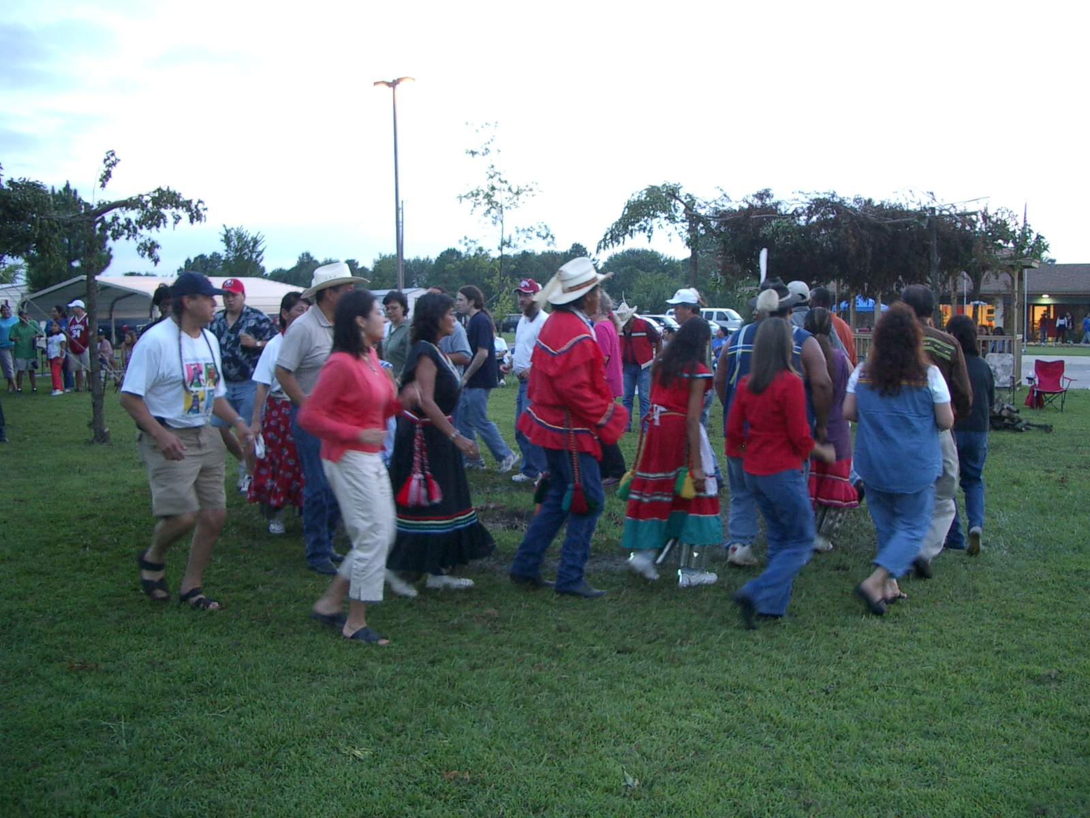
WHAT ARE SOME PROMISING STRATEGIES?
11
Notes:
One Sky Center
6/1/2008
11

Slide 12
An Ideal Intervention
Broad based:
Includes individual, family,
community, tribe and society
Comprehensive:
Prevention: Universal, Selective,
Indicated
Treatment
Maintenance

Slide 13
AI/AN Prevention, Treatment, and Rehabilitation Interventions
Vision Quest
Flute playing/meditation
Reconciliation
Mentoring
Service learning
Traditional Experiences Preservation
Story Telling
Talking Circles
Sweat Lodge
Ceremonies and Ritual
  Purification
  Passages
  Naming
  Grieving
Drumming, singing, dancing

Slide 14
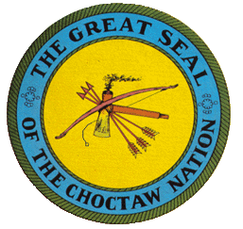
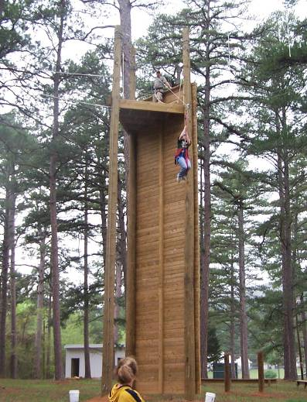
Choctaw Nation of Oklahoma
Adventure Therapy
“Natural Highs Program”
Transformation process
Experiential activities
Relationship building
Changing the way you live and think
Changing how you think and how you believe about life and yourself
Creation of challenge in a safe environment
Horses, Canoes, Tradition Camps
Notes:
Is this the next area for EBP? Feedback to date; Find pleasure, Trust in others, Sharing ideas, Leadership potential, Part of a team.

Slide 15
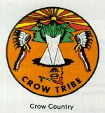
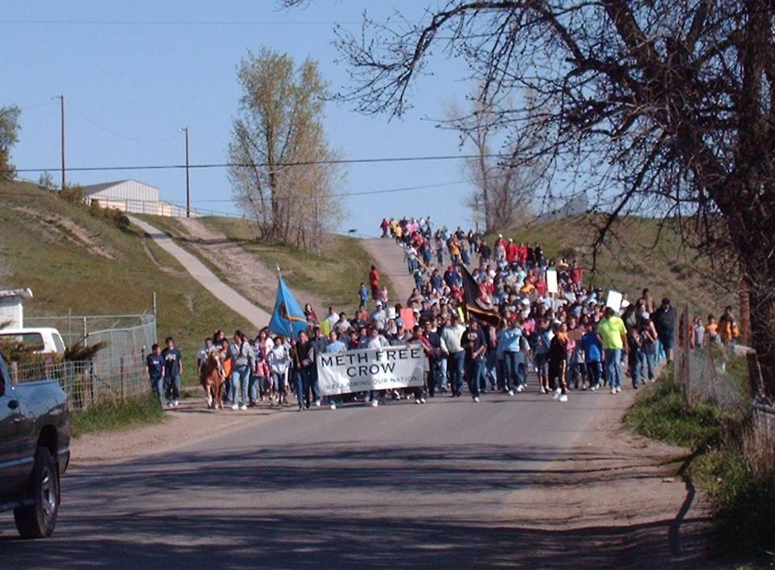
Meth Free Crow Walk: Youth as our Warriors in Reclaiming our Nation
Meth Free Crowalition
Establish a “War Against Meth” Focus on accountability, prevention, intervention, and treatment
Combine forces for Unity.
Diverse community representation
Youth and Community Development: mentorship, leadership, trust, establish community norms
Notes:
Does community mobilization impact prevalence and reduce use?

Slide 16

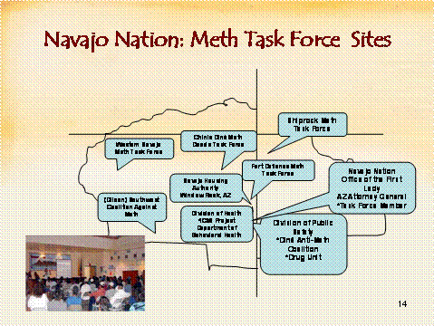
Dine Nation: What Works?
Community Education
  Age-appropriate presentations,
  brochures, ads
Enforcement
  Arrest and detainment
  for trafficking
Caring members of the
community
Partnerships
  Communities, chapters, private businesses
  and tribal divisions and programs
Training for best, evidence based practice, integrated public health model.
Experienced at mobilizing communities across large area for interventions.
Notes:
Community Education through presentations, brochures, advertisements, etc. Age appropriate information shared with youth and adults.
Enforcement: The Navajo Law Enforcement Drug Unit Arrest and detainment of individuals trafficking methamphetamine.
Caring members of the community.
Partnerships with various entities, communities, chapters, private businesses and tribal divisions and programs.

Slide 17

Northern Arapaho Tribe: a Comprehensive Systems Plan
The Problem:
  “turf”
  gaps
  duplications
  crossed purposes
Fragmented Service System
  The Solution: “Works”
  client-centered
  multi-agency
  comprehensive
  coordinated
  Efficient
Implement Best Practice Treatment
  1.Multi-Systemic Family Therapy
  2.Critical Incident Counseling
Notes:
A place to study Evidence based treatment

Slide 18
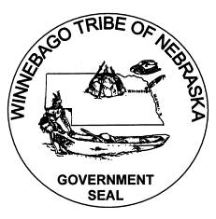
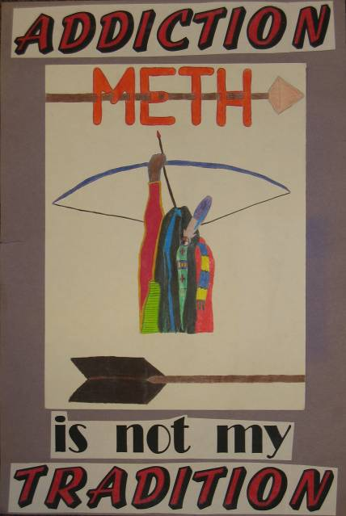
Winnebago Tribe: Meth Task Force Goals and Objectives
Develop/maintain a Comprehensive Meth Prevention Strategy
Collectively plan and implement
Use Proactive measures
Use available funds - take immediate action
Working together to determine what fits
Broad based, multi-agency, systematic, family/community focused prevention-
Will it reduce treatment need?
Notes:
Starting at the center of the diagram tribal leadership initiated and continues to play an important role through participation. The Council is key to ensuring necessary partners continue to be engaged in carrying out the strategic plan as it is updated regularly. The Task force includes at least 2 Tribal Council members, law enforcement, court, most if not all tribal and community agencies and federal officials including: Tribal Health Department (including; education, mental health, alcohol program), Tribal Human Services (child protective services), Tribal Environmental Offices, Tribal Housing Office, Local Housing Authority, Weed and Seed program, Ho-Chunk Community Development Corporation, U.S. Attorney’s office representation, FBI victims advocate representative, and others. Through building and maintenance of an effective strategy the strategy has included Tribal codes, policies and procedures, enforcement as a priority, awareness campaigns, education, screening, and compassion as an approach to controlling methamphetamine on the Winnebago Reservation. The result has been the use of methamphetamine has been minimized.

Slide 19
“Best Practices”
Families and Schools Together (Rural Wisconsin Res)
Parenting Wisely
Preparing for Drug Free Years
Project Alert
Project Venture (NIYLP)
Promoting Alternative Thinking Strategies
American Indian Life Skills (Zuni Pueblo)
Notes:
FAST is a family strengthening and parent involvement program by Families and Schools Together Inc. FAST is a natively science-based, multi-component, non-curricular multifactorial family strengthening and parent involvement program that is delivered in schools and communities using multifamily group interaction
Parenting Wisely (PW) is a parenting skills education system. The PW programs are designed to facilitate the learning of necessary skills for the healthy well-balanced raising of children from age 3 to 18
Preparing for the Drug Free Years (PDFY), a program for parents of children in grades 4 through 8, is designed to reduce adolescent drug use and behavior problems. PDFY's skill-based curriculum helps parents address risks that can contribute to drug abuse while strengthening family bonding by building protective factors.
Project ALERT is a focused, classroom-based adolescent substance abuse prevention program. The program was designed to motivate students against drug use, to provide skills and strategies for resisting use, and to establish non-use attitudes and beliefs.
Youth in Project Venture experience challenging activities, including rock climbing, rappelling, canoeing, backpack trips, ropes course, mountain biking, orienteering, as well as service-learning projects and cultural activities that support their development as capable, productive members of their community.
The PATHS (Promoting Alternative THinking Strategies) Curriculum is a comprehensive program for promoting emotional and social competencies and reducing aggression and behavior problems in elementary school-aged children while simultaneously enhancing the educational process in the classroom.
The American Indian Life Skills Development curriculum is a school-based, culturally tailored, suicide-prevention curriculum for American Indian adolescents. Tailored to American Indian norms, values, beliefs, and attitudes, the curriculum is designed to build self-esteem; identify emotions and stress; increase communication and problem-solving skills; and recognize and eliminate self-destructive behavior, including substance abuse
Across Ages is a school- and community-based drug prevention
program for youth 9 to 13 years old that seeks to strengthen the bonds
between adults and youth and to provide opportunities for positive
community involvement. The unique and highly effective feature of Across
Ages is the pairing of older adult mentors (age 55 and above) with young
adolescents, specifically youth making the transition to middle school.

Slide 20
“Best Practices”
Cultural Enhancement Through Story Telling (Tohono O’odham Res)
AI Strengthening Families Program (U UT)
Creating Lasting Family Connections
Dare to Be You (Ute Res)
With Eagles Wings (N. Arapaho Nat)
Families That Care—Guiding Good ChoicesAcross Ages (Mentoring) (Temple U)
Across Ages (Mentoring) (Temple U)
Notes:
And some more.

Slide 21
Effective Treatment Approaches For Methamphetamine Use Disorder
Motivational Interviewing
Therapeutic Use of Urine Testing
Contingency Management ( motivational incentive based)
Cognitive Behavioral Therapy - CBT
Community Reinforcement Approach
Matrix Model (combination of above)
Notes:
Motivational interviewing is non-judgmental, non-confrontational and non-adversarial. The approach attempts to increase clients’ awareness of the potential problems caused, consequences experienced, and risks faced as a result of the behavior in question
The premise behind CM is to utilize these and other reinforcement procedures systematically to modify behaviors of substance abusers in a positive and supportive manner (Petry, 2000). For example, in many CM treatments, patients leave urine specimens multiple times each week and receive explicit rewards for each specimen that tests negative for drugs
The Community Reinforcement Approach (CRA) is a comprehensive behavioral program for treating substance-abuse problems. It is based on the belief that environmental contingencies can play a powerful role in encouraging or discouraging drinking or drug use. Consequently, it utilizes social, recreational, familial, and vocational reinforcers to assist consumers in the recovery process. Its goal is to make a sober
lifestyle more rewarding than the use of substances.
The Matrix Model intensive outpatient treatment was developed with an awareness of the diversity of factors that contribute to drug and alcohol problems. To produce the best opportunity for success, the needs of the individual patient are considered in the design of each treatment plan. At Matrix Institute, the elements chosen to create optimal treatment for adults and adolescents include strategies and methods that have been demonstrated to be effective in helping people who are abusing drugs or alcohol. These elements are listed below and are included within all Matrix treatment plans.

Slide 22
Matrix Model
Is a manualized, 16-week, non-residential, psychosocial approach used for the treatment of drug dependence
Designed to integrate several interventions into a comprehensive approach. Elements include:
  Individual counseling
  Cognitive behavioral therapy
  Motivational interviewing
  Family education groups
  Urine testing
  Participation in 12-step programs

Slide 23
Contingency Management
Key concepts
    Behavior to be modified must be objectively measured
    Behavior to be modified (eg urine test results) must be monitored frequently
    Reinforcement must be immediate
    Penalties for unsuccessful behavior (eg positive UA) can reduce voucher amount
    Vouchers may be applied to a wide range of prosocial alternative behaviors

Slide 24
Is Treatment for Methamphetamine Effective?
Analysis of:
Drop out rates
Retention in treatment rates
Re-incarceration rates
Other measures of outcome
All these measures indicate that Meth users respond in an equivalent manner as do individuals admitted for other drug abuse problems.

Slide 25
Youth Treatment Completion: WA State

Slide 26
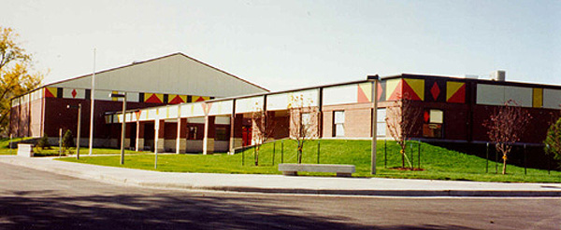
Comprehensive School and Behavioral Health Partnership
Prevention and behavioral health programs/services on site
Handling behavioral health crises
Responding appropriately and effectively after an event occurs

Slide 27
Integrated Treatment
Premise: treatment at a single site, featuring coordination of treatment philosophy, services and timing of intervention will be more effective than a mix of discrete and loosely coordinated services
Findings:
decrease in hospitalization
lessening of psychiatric and substance abuse severity
better engagement and retention
(Rosenthal et al, 1992, 1995, 1997; Hellerstein et al 1995.)

Slide 28
Partnered Collaboration
Grassroots Groups
Community-Based
Organizations
Research-Education-Treatment

Slide 29
Potential Organizational Partners
Law Enforcement
Juvenile Justice
Medical Examiner
Faith-Based
County, State, and Federal Agencies
Student Groups
Education
Family Survivors
Health/Public Health
Mental Health
Substance Abuse
Elders, traditional

Slide 30
Contact us at:
503-494-3703
E-mail: Dale Walker, MD
onesky@ohsu.edu
Or visit our website:
www.oneskycenter.org
Rachel Crawford, Association of American Indian Physicians
405-946-7072
E-mail: rcrawford@aaip.org

