Slide 1

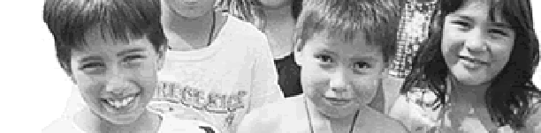
The Indian Country Methamphetamine Initiative: A Model for Integrated Community Based Care
Association of American Indian Physicians
37th Annual Meeting
R Dale Walker, MD
July 28, 2008
Coeur d’Alene Reservation, Idaho
Notes:
1

Slide 2
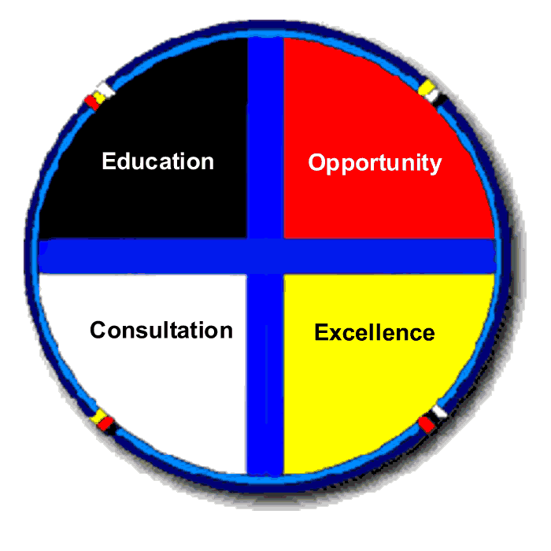
Native Communities
Advisory Council / Steering Committee
One Sky Center

Slide 3

One Sky Center Partners
Cook Inlet Tribal Council
Tribal Colleges and Universities
Alaska Native Tribal Health Consortium
Prairielands ATTC
Red Road
Northwest Portland Area Indian Health Board
One Sky Center
Harvard Native Health Program
United American Indian Involvement
Jack Brown
Adolescent
Treatment Center
National Indian Youth Leadership Project
Tri-Ethnic Center for Prevention Research
Na'nizhoozhi Center

Slide 4
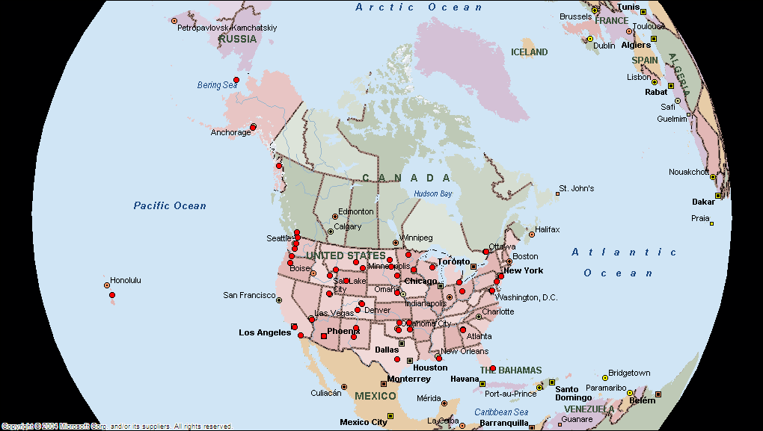
One Sky Center Outreach

Slide 5
Goals for Today
Background: The environment and the system of care
The methamphetamine problem
The methamphetamine initiative
Integrated care approaches are best for treatment of these chronic illnesses
Treatment works!

Slide 6
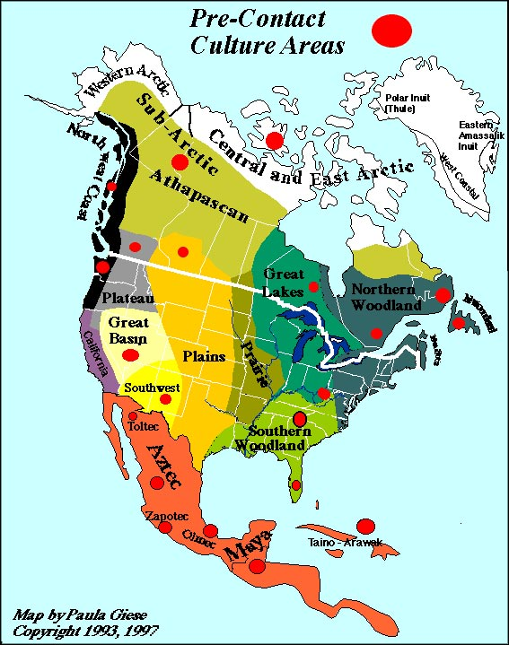

Slide 7
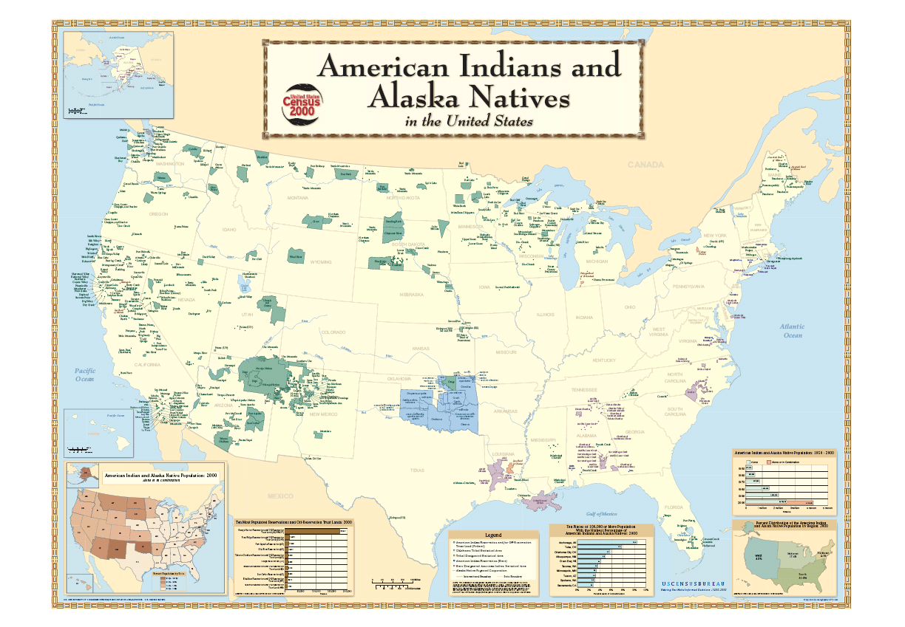

Slide 8
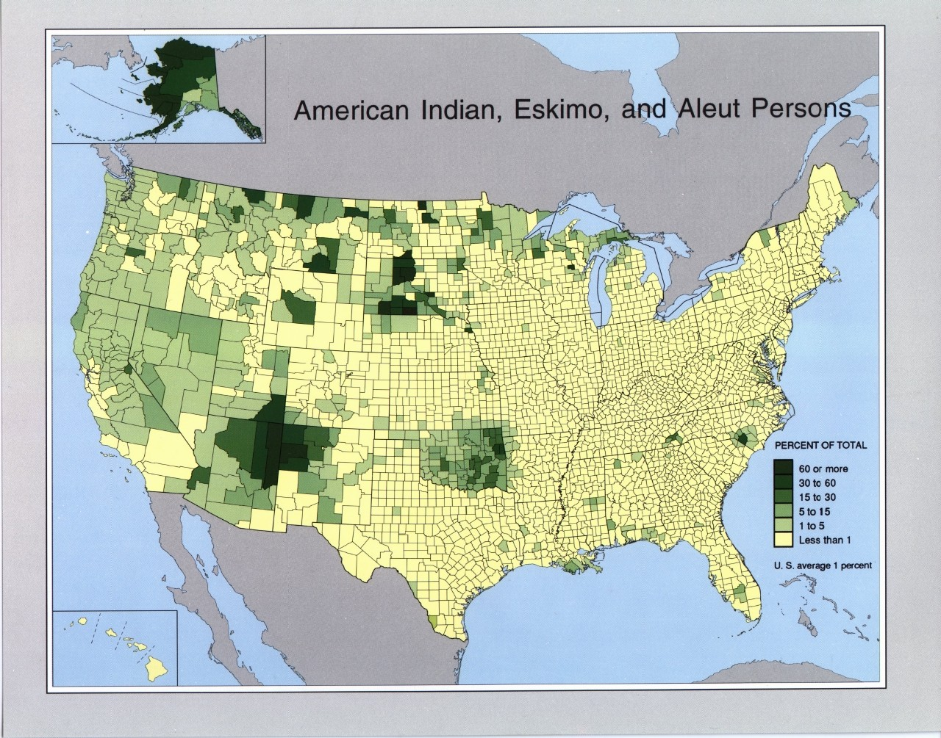

Slide 9
Methamphetamine Identified as the Primary Health/Community Concern
In 2006, Tribal Round Table sessions, HHS Regional Tribal Consultations, and numerous tribal community gatherings with SAMHSA, OMH, and IHS identified Methamphetamine abuse as the primary health concern in Indian Country.
Notes:
Methamphetamine is a powerfully addictive stimulant that dramatically affects the central nervous system. The drug is made easily in clandestine laboratories with relatively inexpenseive over-the-counter ingredients. These factors combine to make methamphetamine a drug with high potential for widespread abuse

Slide 10
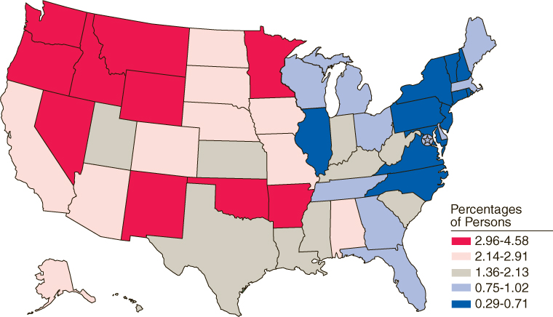
Young Adults (18 to 25) Reporting Past Year Methamphetamine Use: 2002 to 2005
Source: SAMHSA, 2002-2005 .

Slide 11
Methamphetamine: Epidemiology

Slide 12
Why is Methamphetamine so Devastating?
Cheap, readily available
Stimulates, gives intense pleasure
Damages the user’s brain
Paranoid, delusional thoughts
Depression when stop using
Craving overwhelmingly powerful
Brain healing takes up to 2 years
We are not familiar with treating it

Slide 13
The Methamphetamine Effect

Slide 14
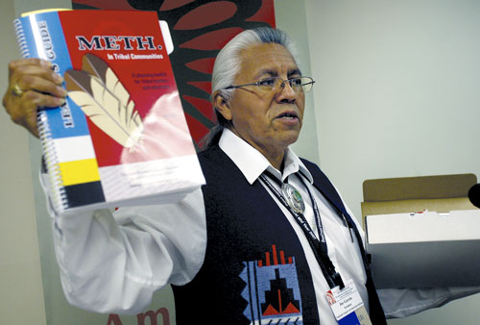
“Tribal leaders unveil new meth Initiative” Indian Country Today
Create a National outreach campaign for all Native communities.
Establish and transfer community based, promising practices for prevention and treatment.
Work across Federal agencies for coordinated and consistent outreach strategy.
NCAI President, Joe Garcia June 15, 2007

Slide 15
ICMI Partners

Slide 16
Tribes Added in Second Year
Chippewa Cree, Montana
San Carlos Apache, Arizona
Salt River, Arizona
Yakama, Washington
Welcome!

Slide 17
Clinical Challenges for Treatment of Methamphetamine Addiction
Poor treatment engagement rates
High dropout rates
Severe paranoia
High relapse rates
Ongoing episodes of psychosis
Severe craving
Protracted dysphoria
Many patients may require medical/psychiatric supervision and need ongoing treatment with antipsychotic medications

Slide 18
ID Best Practice
Best Practice
Clinical/services
Research
Mainstream
Practice
Traditional
Healing

Slide 19
Circle of Care
Traditional
Healers
Child & Adolescent Programs
Primary Care
A&D
Programs
Best
Practices
Boarding
Schools
Colleges &
Universities
Prevention Programs
Emergency
Rooms

Slide 20
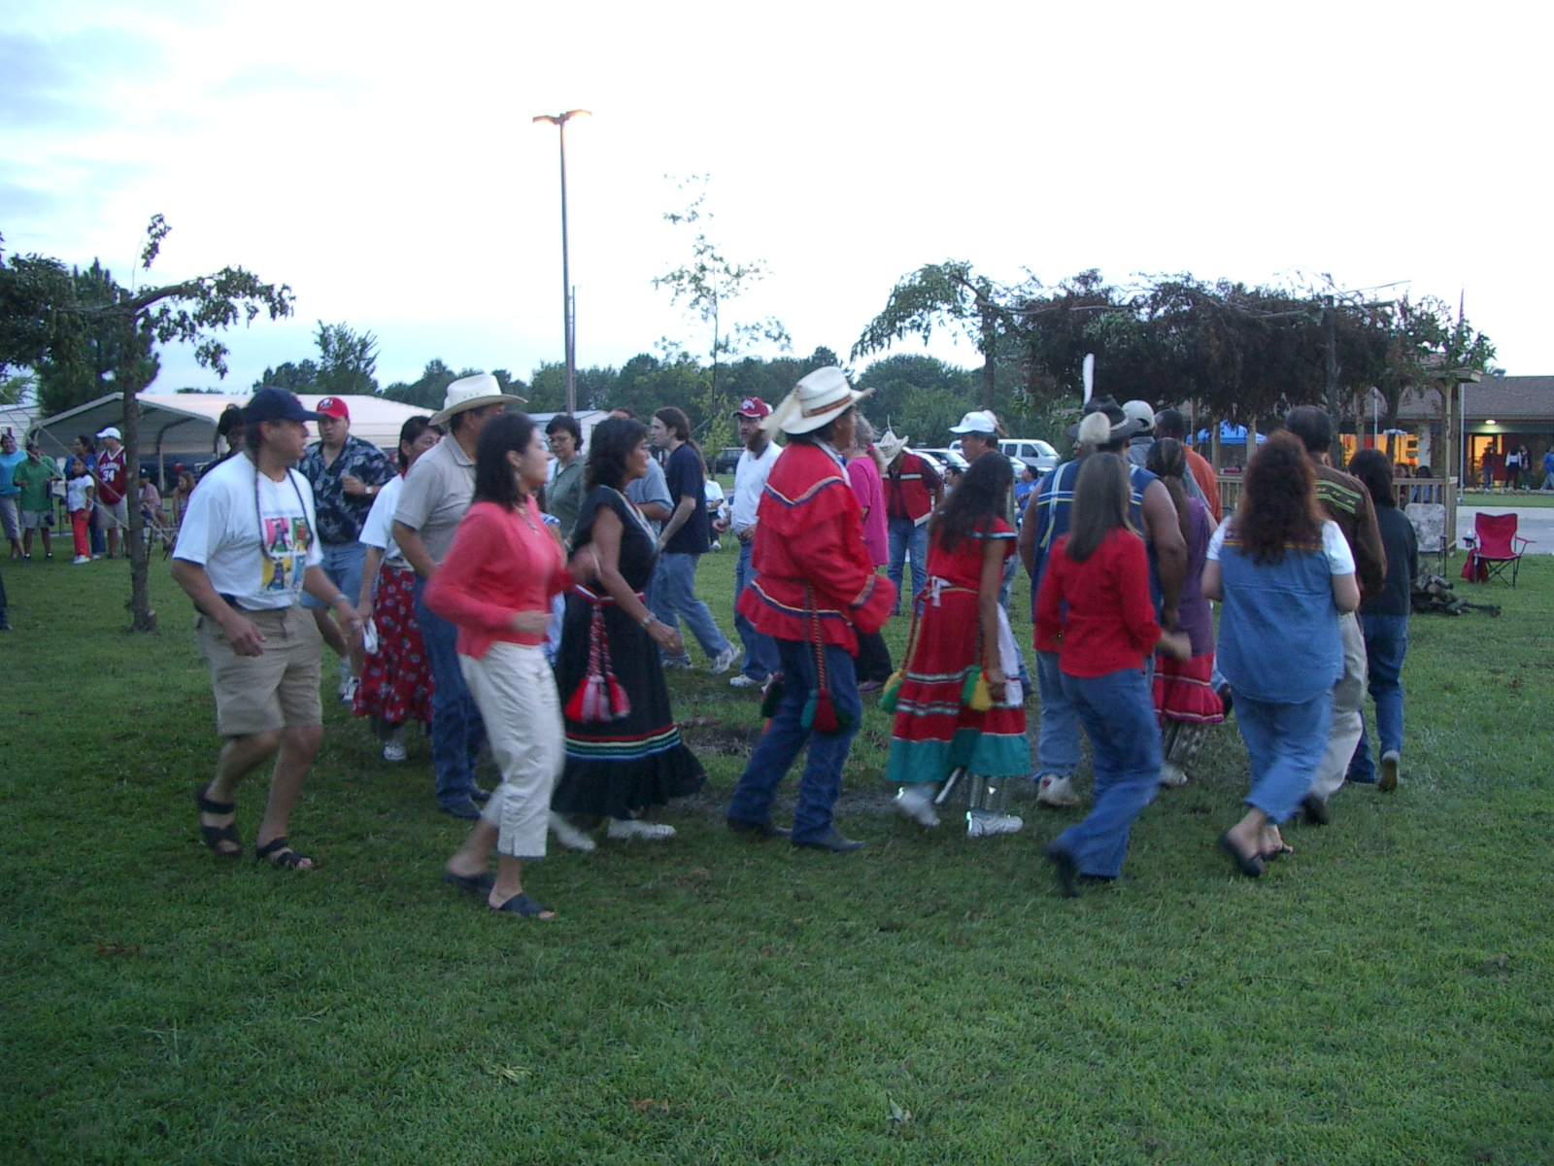
WHAT ARE SOME PROMISING STRATEGIES?
20
Notes:
One Sky Center
7/17/2008
20

Slide 21
An Ideal Intervention
Broadly based:
Includes individual, family,
community, tribe and society
Comprehensive:
Prevention: Universal, Selective,
Indicated
Treatment
Maintenance

Slide 22
Ecological Model
Society
Community/
Tribe
Peer/Family
Individual

Slide 23
Fighting Meth, Healing Families:
Seven Promising Solutions
1. Media Campaigns
2. Expanding Permanency Options
3. Interagency Collaborations
4. New Supports for Grandfamilies
5. Enhancing Treatment Options
6. Family Drug Courts
7. Targeted Community Supports in Indian Country
Notes:
In 2005, the Montana Meth Project began targeting 12- to 17-year-olds, with graphic, disturbing TV commercials, radio ads, billboards, and posters to warn against meth use. Recovery Coaches help parents obtain treatment services and negotiate departmental and judicial requirements associated with recovery and permanency planning.
Subsidized guardianship is an increasingly valuable permanency tool when adoption or reunification with parents is not viable. grandfamilies -- grandparents and other relative caregivers –
Partnerships are critical to ensure that all involved agencies -- from child welfare to law enforcement – are addressing individual needs effectively. One particularly effective model gaining influence nationwide is Drug Endangered Children (DEC) partnerships.
Grandfamilies have become lifelines for millions of children who cannot live with their parents due to meth and other substance abuse.
Comprehensive, readily accessible treatment programs are communities’ best hope have for breaking the cycle of alcohol and drug dependence and helping families stay together. One of the most promising treatment models is comprehensive family treatment, which provides services for both parents and their children.
Family drug courts have been widely lauded as a key ingredient to motivating families to enter and stay in treatment. These special courts handle substance-abusing offenders through comprehensive supervision, frequent drug testing, and immediate sanction and incentives to participate in substance abuse treatment. Drug courts bring all the players -- judges, lawyers, substance abuse treatment professionals, and child protection agencies -- into the process, forcing parents to confront meth use and other substance abuse-related issues.
Children, families, and tribes in the Native American community have been hit particularly hard by the meth crisis. To ensure infants and young children and their relative caregivers receive the full range of early intervention services, developed a comprehensive Developmental Assessment Clinic for children who have tested positive for meth and other drugs at birth.
Policy changes at the federal, state, and local levels must be flexible and broad enough to address a range of current and unforeseen issues.

Slide 24
AI/AN Prevention, Treatment, and Rehabilitation Interventions
Vision Quest
Flute playing/meditation
Reconciliation
Mentoring
Service Learning
Traditional Experiences Preservation
Story Telling
Talking Circles
Sweat Lodge
Ceremonies and Ritual
  Purification
  Passages
  Naming
  Grieving
Drumming, Singing, Dancing

Slide 25
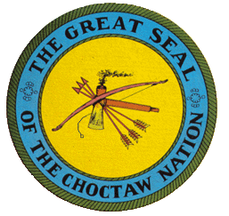
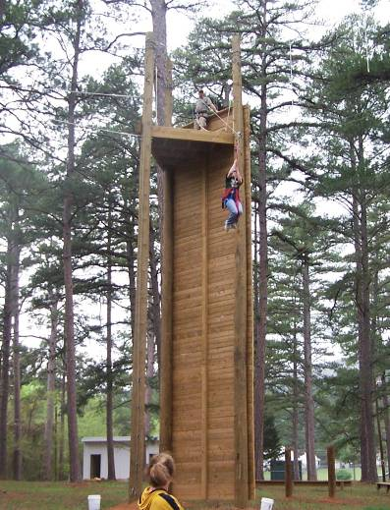
Choctaw Nation of Oklahoma
Adventure Therapy
“Natural Highs Program”
Transformation process
Experiential activities
Relationship building
Changing the way you live and think
Changing how you think and how you believe about life and yourself
Creation of challenge in a safe environment
Horses, Canoes, Tradition Camps
Notes:
Is this the next area for EBP? Feedback to date; Find pleasure, Trust in others, Sharing ideas, Leadership potential, Part of a team.

Slide 26
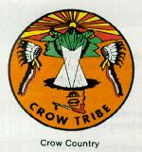
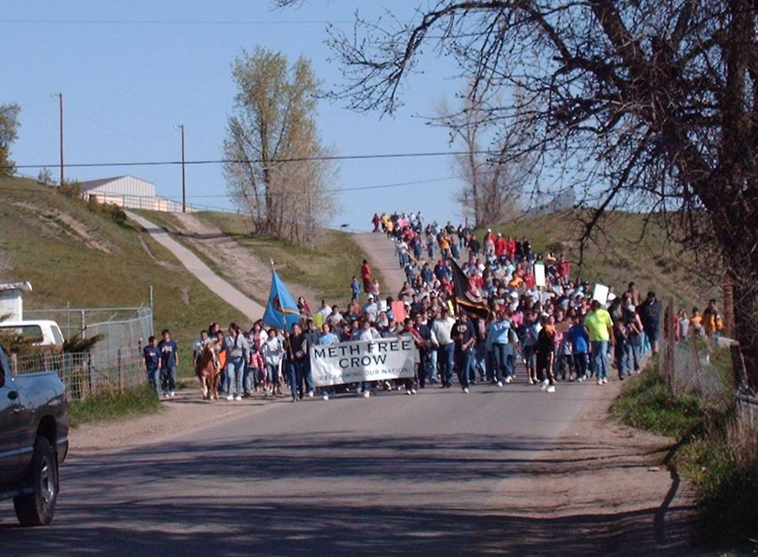
Meth Free Crow Walk: Youth as our Warriors in Reclaiming our Nation
Meth Free Crowalition
Establish a “War Against Meth” Focus on accountability, prevention, intervention, and treatment
Combine forces for Unity.
Diverse community representation
Youth and Community Development: mentorship, leadership, trust, establish community norms
Notes:
Does community mobilization impact prevalence and reduce use?

Slide 27

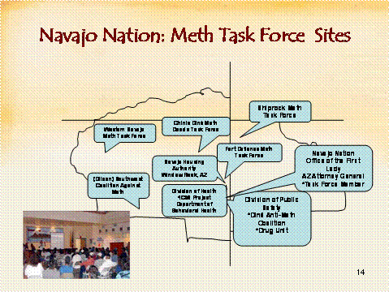
Dine Nation: What Works?
Community Education
  Age-appropriate presentations,
  brochures, ads
Enforcement
  Arrest and detainment
  for trafficking
Caring members of the
community
Partnerships
  Communities, chapters, private businesses
  and tribal divisions and programs
Training for best, evidence based practice, integrated public health model.
Experienced at mobilizing communities across large area for interventions.
Notes:
Community Education through presentations, brochures, advertisements, etc. Age appropriate information shared with youth and adults.
Enforcement: The Navajo Law Enforcement Drug Unit Arrest and detainment of individuals trafficking methamphetamine.
Caring members of the community.
Partnerships with various entities, communities, chapters, private businesses and tribal divisions and programs.

Slide 28

Northern Arapaho Tribe: a Comprehensive Systems Plan
The Problem:
  “turf”
  gaps
  duplications
  crossed purposes
Fragmented Service System
  The Solution: “Works”
  client-centered
  multi-agency
  comprehensive
  coordinated
  Efficient
Implement Best Practice Treatment
  1.Multi-Systemic Family Therapy
  2.Critical Incident Counseling
Notes:
A place to study Evidence based treatment

Slide 29
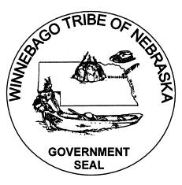
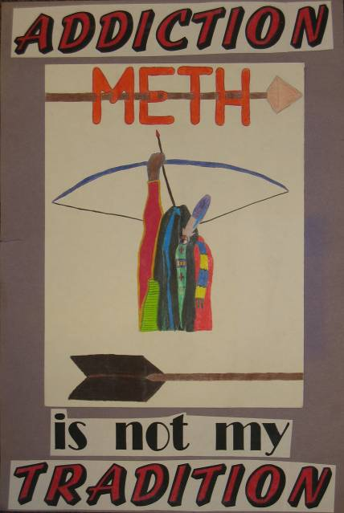
Winnebago Tribe: Meth Task Force Goals and Objectives
Develop/maintain a Comprehensive Meth Prevention Strategy
Collectively plan and implement
Use Proactive measures
Use available funds - take immediate action
Working together to determine what fits
Broad based, multi-agency, systematic, family/community focused prevention-
Will it reduce treatment need?
Notes:
Starting at the center of the diagram tribal leadership initiated and continues to play an important role through participation. The Council is key to ensuring necessary partners continue to be engaged in carrying out the strategic plan as it is updated regularly. The Task force includes at least 2 Tribal Council members, law enforcement, court, most if not all tribal and community agencies and federal officials including: Tribal Health Department (including; education, mental health, alcohol program), Tribal Human Services (child protective services), Tribal Environmental Offices, Tribal Housing Office, Local Housing Authority, Weed and Seed program, Ho-Chunk Community Development Corporation, U.S. Attorney’s office representation, FBI victims advocate representative, and others. Through building and maintenance of an effective strategy the strategy has included Tribal codes, policies and procedures, enforcement as a priority, awareness campaigns, education, screening, and compassion as an approach to controlling methamphetamine on the Winnebago Reservation. The result has been the use of methamphetamine has been minimized.

Slide 30
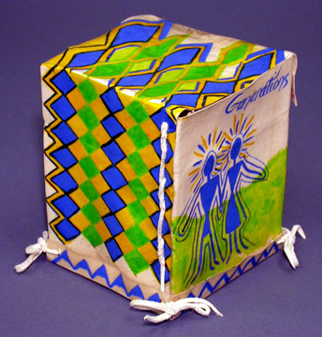
How to Use the Toolkit
Leadership and decision making
Overview of each module
Specific topics, issue pages
Promising Practice approaches
What the culture and science says
Training, technical assistance,
and consultation
Reference documents
Toolkit webpage

Slide 31
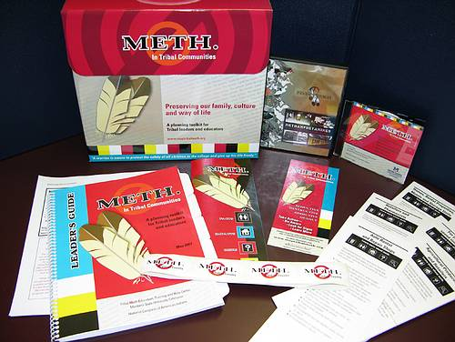
Toolkit Essentials
Leadership Information
Methamphetamine Basics
Tribal Code-Policy
Media
Educational Materials and Presentations
Prevention and Treatment
Educational for Students, Parents, Community
Community Organizing
Fun Youth Items
Additional Resources

Slide 32
“Best Practices”
Families and Schools Together (Rural Wisconsin Res)
Parenting Wisely
Preparing for Drug Free Years
Project Alert
Project Venture (NIYLP)
Promoting Alternative Thinking Strategies
American Indian Life Skills (Zuni Pueblo)
Notes:
FAST is a family strengthening and parent involvement program by Families and Schools Together Inc. FAST is a natively science-based, multi-component, non-curricular multifactorial family strengthening and parent involvement program that is delivered in schools and communities using multifamily group interaction
Parenting Wisely (PW) is a parenting skills education system. The PW programs are designed to facilitate the learning of necessary skills for the healthy well-balanced raising of children from age 3 to 18
Preparing for the Drug Free Years (PDFY), a program for parents of children in grades 4 through 8, is designed to reduce adolescent drug use and behavior problems. PDFY's skill-based curriculum helps parents address risks that can contribute to drug abuse while strengthening family bonding by building protective factors.
Project ALERT is a focused, classroom-based adolescent substance abuse prevention program. The program was designed to motivate students against drug use, to provide skills and strategies for resisting use, and to establish non-use attitudes and beliefs.
Youth in Project Venture experience challenging activities, including rock climbing, rappelling, canoeing, backpack trips, ropes course, mountain biking, orienteering, as well as service-learning projects and cultural activities that support their development as capable, productive members of their community.
The PATHS (Promoting Alternative THinking Strategies) Curriculum is a comprehensive program for promoting emotional and social competencies and reducing aggression and behavior problems in elementary school-aged children while simultaneously enhancing the educational process in the classroom.
The American Indian Life Skills Development curriculum is a school-based, culturally tailored, suicide-prevention curriculum for American Indian adolescents. Tailored to American Indian norms, values, beliefs, and attitudes, the curriculum is designed to build self-esteem; identify emotions and stress; increase communication and problem-solving skills; and recognize and eliminate self-destructive behavior, including substance abuse
Across Ages is a school- and community-based drug prevention
program for youth 9 to 13 years old that seeks to strengthen the bonds
between adults and youth and to provide opportunities for positive
community involvement. The unique and highly effective feature of Across
Ages is the pairing of older adult mentors (age 55 and above) with young
adolescents, specifically youth making the transition to middle school.

Slide 33
“Best Practices”
Cultural Enhancement Through Story Telling (Tohono O’odham Res)
AI Strengthening Families Program (U UT)
Creating Lasting Family Connections
Dare to Be You (Ute Res)
With Eagles Wings (N. Arapaho Nat)
Families That Care—Guiding Good ChoicesAcross Ages (Mentoring) (Temple U)
Across Ages (Mentoring) (Temple U)
Notes:
And some more.

Slide 34
Effective Treatment Approaches For Methamphetamine Use Disorder
Motivational Interviewing
Therapeutic Use of Urine Testing
Contingency Management ( motivational incentive based)
Cognitive Behavioral Therapy - CBT
Community Reinforcement Approach
Matrix Model (combination of above)
Notes:
Motivational interviewing is non-judgmental, non-confrontational and non-adversarial. The approach attempts to increase clients’ awareness of the potential problems caused, consequences experienced, and risks faced as a result of the behavior in question
The premise behind CM is to utilize these and other reinforcement procedures systematically to modify behaviors of substance abusers in a positive and supportive manner (Petry, 2000). For example, in many CM treatments, patients leave urine specimens multiple times each week and receive explicit rewards for each specimen that tests negative for drugs
The Community Reinforcement Approach (CRA) is a comprehensive behavioral program for treating substance-abuse problems. It is based on the belief that environmental contingencies can play a powerful role in encouraging or discouraging drinking or drug use. Consequently, it utilizes social, recreational, familial, and vocational reinforcers to assist consumers in the recovery process. Its goal is to make a sober
lifestyle more rewarding than the use of substances.
The Matrix Model intensive outpatient treatment was developed with an awareness of the diversity of factors that contribute to drug and alcohol problems. To produce the best opportunity for success, the needs of the individual patient are considered in the design of each treatment plan. At Matrix Institute, the elements chosen to create optimal treatment for adults and adolescents include strategies and methods that have been demonstrated to be effective in helping people who are abusing drugs or alcohol. These elements are listed below and are included within all Matrix treatment plans.

Slide 35
Matrix Model
Is a manualized, 16-week, non-residential, psychosocial approach used for the treatment of drug dependence
Designed to integrate several interventions into a comprehensive approach. Elements include:
  Individual counseling
  Cognitive behavioral therapy
  Motivational interviewing
  Family education groups
  Urine testing
  Participation in 12-step programs

Slide 36
Contingency Management
Key concepts
    Behavior to be modified must be objectively measured
    Behavior to be modified (eg urine test results) must be monitored frequently
    Reinforcement must be immediate
    Penalties for unsuccessful behavior (eg positive UA) can reduce voucher amount
    Vouchers may be applied to a wide range of prosocial alternative behaviors

Slide 37
Is Treatment for Methamphetamine Effective?
Analysis of:
Drop out rates
Retention in treatment rates
Re-incarceration rates
Other measures of outcome
All these measures indicate that Meth users respond in an equivalent manner as do individuals admitted for other drug abuse problems.

Slide 38
Youth Treatment Completion: WA State

Slide 39
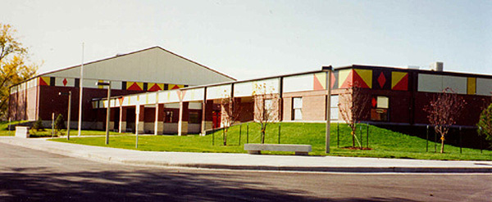
Comprehensive School and Behavioral Health Partnership
Prevention and behavioral health programs/services on site
Handling behavioral health crises
Responding appropriately and effectively after an event occurs

Slide 40
Integrated Treatment
Premise: treatment at a single site, featuring coordination of treatment philosophy, services and timing of intervention will be more effective than a mix of discrete and loosely coordinated services
Findings:
decrease in hospitalization
lessening of psychiatric and substance abuse severity
better engagement and retention
(Rosenthal et al, 1992, 1995, 1997; Hellerstein et al 1995.)

Slide 41
Partnered Collaboration
State/Federal
Grassroots Groups
Community-Based
Organizations
Research-Education-Treatment

Slide 42
Potential Organizational Partners
Education
Family Survivors
Health/Public Health
Mental Health
Substance Abuse
Elders, traditional
Law Enforcement
Juvenile Justice
Medical Examiner
Faith-Based
Student Groups
County, State, and Federal Agencies

Slide 43
Problem is bigger, broader and more complex than current solutions
Broad-based, integrated, interagency changes are needed
State, county, and city relationships to be developed with tribes and communities
Training and tribal leadership development
A Marshall Plan for all Native America that effects: economics, housing, social services, education, law/governance, and health

Slide 44
One Sky Center
Contact us at:
503-494-3703
E-mail: Dale Walker, MD
onesky@ohsu.edu
Or visit our website:
www.oneskycenter.org
Rachel Crawford, Association of American Indian Physicians
405-946-7072
E-mail: rcrawford@aaip.org

