Slide 1
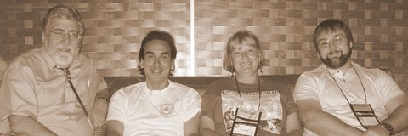
Connections and Collaborations: Addressing the Health Needs of American Indian Populations
Developing Leadership in Health Disparities. APA 119th Convention
Washington, DC. August 6, 2011
Notes:
Abstract:
The American Indian/Alaska Native population comprises about 1.5 percent of the U. S. population or approximately 4.5 million people. Their representation in research and science is low which is also seen in their low representation in leadership positions in academia, government and professional associations. Given these low numbers, the importance of establishing a critical mass of Ai/AN scholars across discipline and professional boundaries will be discussed and the role that the AI/AN can play in this process. The presenter will also discuss efforts to increase the participation of American Indian/Alaska Native scholars in research and leadership position, focusing on the role of the Association of American Indian Physicians and a Native Mentorship Program in Addictions. The Native Mentorship program recruits AI/AN scholars across the educational and career pipeline and pairs them with established mentors from varying disciplines to encourage their participation in substance abuse research and related health concerns of AI/AN communities. They receive skills training in areas such as scientific writing and grant development, but most importantly they are encouraged to become deep thinkers and proficient advocates for American Indian health issues. Outcomes of the first cohort of mentees will be shared. Other topics that will be addressed include coalition building and networking with other groups, especially psychologists, and professional associations to maximize efforts and gain allies, challenges of recruiting AI/NA scholars into research and academia, and concerns about the development of community informed, evidence-based practices appropriate for AI/AN.
1

Slide 2
Presentation Objectives
Introduce Mentors and Mentees
Goals and Objectives
Why the Need for Mentoring
Logic Model
Expectations, Goals, Objectives
Establishing Working Relationships
Assessment and Working Together
Mentorship Webpage
Annual Conference
Notes:
Ideally, the mentoring relationship should benefit trainee, mentor, sponsoring institution, and science. However, the reality is that not all successful researchers have had mentors, and not all mentor/trainee relationship end successfully. Each research institution has its own perspective on the value of mentoring, and how deeply it is willing to invest in the practice. Nevertheless, potential mentors and trainees should become familiar with likely responsibilities as well as the benefits and costs of this relationship.

Slide 3
NIDA Native Scholars Workgroup and Mentors
Workgroup Member and Mentors:
Deloris Big Foot, PhD, Oklahoma
Ray Daw, MA , New Mexico (Co-Chair)
Joseph Gone, PhD, Michigan
Clyde McCoy, PhD, Florida
Dennis Norman, PhD , Massachusetts
Bernard Segal, PhD, Alaska
Sallie Stevens, PhD, Arizona (On leave)
Pamela Jumper Thurman, PhD, Colorado
Kamilla Venner, PhD, New Mexico
R. Dale Walker, MD, Oregon (Co-Chair)
Karina Walters, PhD, Washington
Additional Mentors:
Art Blume, PhD, Washington
Felicia Hodge, PhD, California
Jenny Joe, PhD, MPH, Arizona
Theresa LaFromboise, PhD, California
Patricia Silk Walker, PhD, Oregon
Joseph Trimble, PhD, Washington
Associates: Non-Native researchers with Native Research Experience in Substance Abuse

Slide 4
Current Mentees
Active:
Jamie Bartgis, PhD, Director of Technical Assistance and Research, National Council on Urban Indian Health , Washington, DC
Michelle Begay, MS, Public Health Advisor , Indian Health Service, Phoenix, AZ
Melissa Deer, MD, Chief Resident, Psychiatry and Internal Medicine, San Diego, CA
Dan Dickerson, DO, MPH. General Psychiatry and Addictions Psychiatry. Assistant Research Psychiatrist, U.C.L.A. Los Angeles, CA
Caleb Dunlap, BS, studying for MCAT, Sacramento, CA
Jared Dunlap, BS, studying for MCAT, Sacramento, CA
Jacque Gray, PhD, Assistant Professor , Center for Rural Health, University of North Dakota, ND
Kimberly Johnson, BA, MS student, Public Health , accepted into PhD program in Health Promotion Sciences, Claremont Graduate University, Claremont, CA,
KIMBERLY A. MILLER, Ph.D, Research Assistant Professor. Tri-Ethnic Center for Prevention Research Department of Psychology. Colorado State University. Fort Collins, Colorado
Sandra L. Momper, PhD. Assistant Professor of Social Work. School of Social Work. University of Michigan. Ann Arbor, MI
Motanic, Kelsey, BS, Post-Bac IRTA Fellow, at NIH/section at the National Institute of Neurological Disorders and Stroke in Bethesda, MD.
Danielle, Tsingine, BS, Premed, Coordinator, Training & Scholarship Program. Johns Hopkins Bloomberg School of Public Health, Center for American Indian Health. Baltimore, MD.
Melissa L Walls, PhD. Assistant Professor, Department of Sociology-Anthropology, University of Minnesota-Duluth, MN
James Wood, MS. Psychology. Doctoral student. Colorado State University. Fort Collins, CO
Julie Yaekel Black Elk, PhD, Therapist, Lac Courte Oreilles Health Services, Hayward, WI
Two candidates are completing the application process
The mentees below have completed work but are continuing contact
Michael Dekker, DO, Resident in Psychiatry. Phoenix, AZ
Jordan Lewis, MSW. PhD, Assistant Professor , Department of Alaska Native Studies, University of Alaska Fairbanks , AK
Olivia Belen Sloan, BS, MPH student, and Former Coordinator, Training & Scholarship Program. Johns Hopkins Bloomberg School of Public Health, Center for American Indian Health. Baltimore, MD.
Erick Willie, BS, Psychology. Working on Masters Degree, Applying for PhD. Practicing to be a medicine man. Gallup, NM
Notes:
Add info

Slide 5
NIDA Support Staff
Lula A. Beatty, Ph.D. Chief, Special Populations Office National Institute on Drug Abuse/NIH 301.443.0441 lbeatty@nida.nih.gov
Kathy Etz, PhD, Epidemiology Research Branch. 301-402-1749 ketz@mail.nih.gov
Wilson M Compton, MD, MPE, Director, Division of Epidemiology, Services and Prevention Research

Slide 6
NIDA Native Mentorship
Mentors: 17
Mentees: 21

Slide 7
NIDA Workgroup Goals
Increase and retain underrepresented minority investigators (American Indian, Alaska Native and Native Hawaiian) who conduct substance abuse and addiction research
Establish effective communication pathways for recruitment of new investigators or candidates for training positions at NIDA

Slide 8
Native Workgroup Objectives
Education of public, students, health practitioners and researchers on addiction in the AI/AN/NH population as well as associated co-morbidities
Enhance research competency
Develop research concepts
Advocate for the grant application process
Understand and maintain Native community based research
Mentoring of Native students and early career faculty

Slide 9
Specific Native Disparity Concerns
>50% Native Americans entering as college freshman will leave after their first year.
Native American retention rate is 15% below the national average.
About 20 will enter college and only 3 will graduate with a four-year degree
Source: National Institute for Native Leadership in Higher Education, 2002
Major Shortage of American Indian Health Professionals

Slide 10
Why Develop a Native Mentoring Program?
Provide instruction on conducting research
Provide insight into Native identity – Personal and Community
Improve trainee's self-confidence
Critique and support trainee's research
Assist in defining and achieving career goals
Socialize trainee into the profession
Assist in development of collegial networks
Advise how to balance work and personal life
Assist in the development of future colleagues

Slide 11
Native Mentorship Goals
Mentor and train American Indian students and early career faculty interested in substance abuse and addictions research
Pair Mentees with Mentors and encourage training, site visits, and professional development
Assist in identification and recruitment of candidates for NIDA training opportunities
Maintain a website at www.oneskycenter.org to identify Mentors, Mentees, faculty/student interests and projects, and NIDA agenda.
Enhance Native community awareness and involvement
Attend and participate in National Scientific Conferences that focus on American Indian Health and/or addictions research

Slide 12
The 5 Elements of Mentoring Program
Recruit: Define eligibility, market program, conduct information sessions
Screen: applications, reference checks, interviews, orientation
Train: Overview of the program, role clarification, situational “how-to’s”
Match: Establish criteria, ensure all parties understand and agree to the terms and conditions of participation
Monitor: Continuing training opportunities, regular communication, goal setting and achievement, conflict resolution, documentation

Slide 13
Native Mentoring Logic Model
Predoctoral
Doctoral
Postdoctoral
Junior Mentor
Senior Mentor
Interactive Mentoring Relationships:
A mentee will have a primary mentor and have access to all mentors, mentees, their academic institutions, NIDA and NIAAA

Slide 14
Mentor Responsibilities: Competing ISSUES
Mentoring?
Advising
Community Involvement
Family
Tribal
Spiritual
Advocacy
Teaching Students
Clinical Service
Research
Academic Travel
Grant
Proposals
Personal Time

Slide 15
Mentee Self-assessment
What are my research ambitions?
What are my current research skills and knowledge?
What are some possible research interests I have?
What support do I need to pursue those research interests responsibly?
What do I need to advance my faculty career?
What is the timetable to complete my education/training/promotion?

Slide 16
Types of Mentorship Contact
Face-to-Face
Especially for important and/or confidential issues
Attend national and regional conferences as mentor/mentee teams
Discuss career objectives and strategies to accomplish those
Co-present at conferences
Have lunch/break together at meetings
E-mail
Alert mentees to programs and new information
For mentees to ask quick questions, seek direction
Reminders about programs, etc.
Phone
Set up strategy meetings and touch base
When confidentiality and tone of voice are critical, face-to-face is not practical and email won’t do
Web site
Reference materials, data links and news

Slide 17
What Mentees May Gain:
Understanding of identity issues
Strategies for community problem solving
Greater chances for success in academic careers
Increased resilience through increased resources and support
Gain skills of learning in another mode
Value and understand benefits of mentor/protégé relationship

Slide 18
Mentorship Activities
Attend scientific conferences with Native researchers and Native/Community themes and policy
Discuss research methods tailored to individual needs
A. Questions, design, statistics, ethics
B. Methods in community based research
3. Discuss grant applications and management
A. Writing proposals, find funding, career
development, writing papers, networking
B. Budgeting time, effort, and funds
C. Mock NIMH review sessions
4. Develop Mentee-needs specific Workshops

Slide 19
Mentorship: Areas for Discussion
Culture, politics, and identity
How to set special research plans (short and long)
Schedule for submitting articles and grant proposals
The publication process
Course planning, teaching strategies, mentoring students
Departmental relations
Time management and professional/personal balance
Tenure and promotion process and expectations
Substantive, theoretical and methodological interests

Slide 20
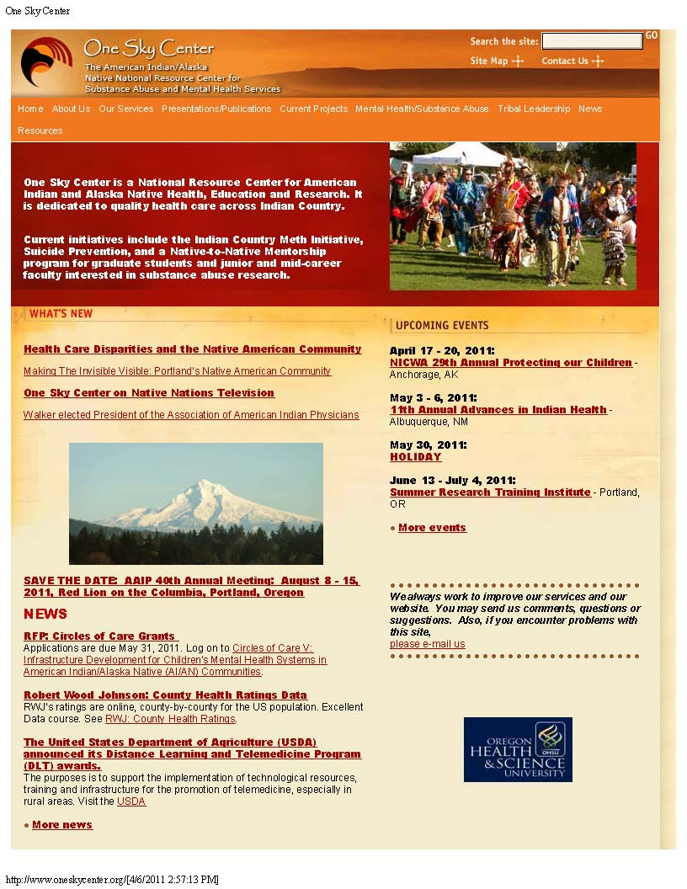
Current Projects
NIDA Mentorship
Introduction
Mentors and Staff
Mentees
News, Recruitment, Links

Slide 21
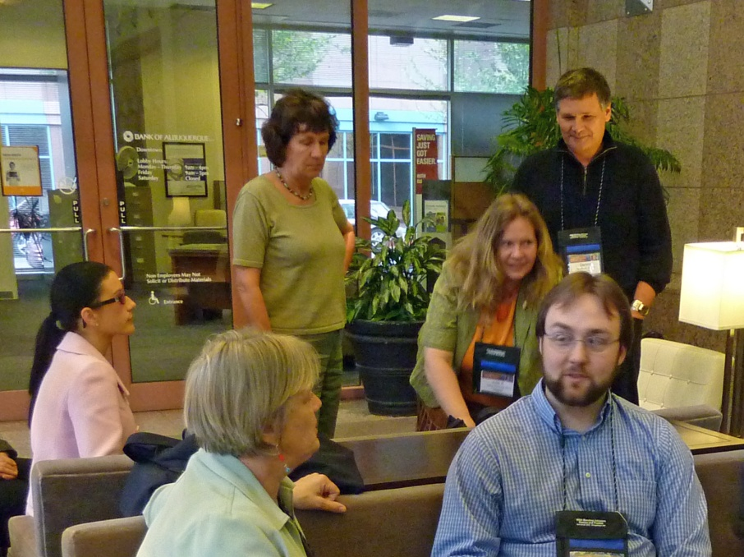
Mentees

Slide 22
Attend 40 Annual Conference of The Association of American Indian Physicians (AAIP)
“Shared Visions: Blending Tradition, Culture, and Health Care for Our Native Communities”
Mentorship focused Workshop
Attend Scientific Sessions of AAIP conference
Primarily American Indian presenters and attendees
National leaders in Native research
Conference sessions debriefed daily vis-à-vis academic and scientific career goals
Networking and relationship building
Portland, Oregon, August 9-14, 2011

Slide 23
Agenda for Mentorship Group
Participate in a Mentorship Specific Workshop
Participate in AAIP meeting
Attend scientific sessions, organized activities and community activities
Meet throughout the conference with mentors, mentees, and others
Goal 1: Learn and advance mentee-mentor personal goals and directions
Goal 2: Search for potential students and mentors
Goal 3: Experience a large Native/Scientific meeting with Federal officials, advisors

Slide 24
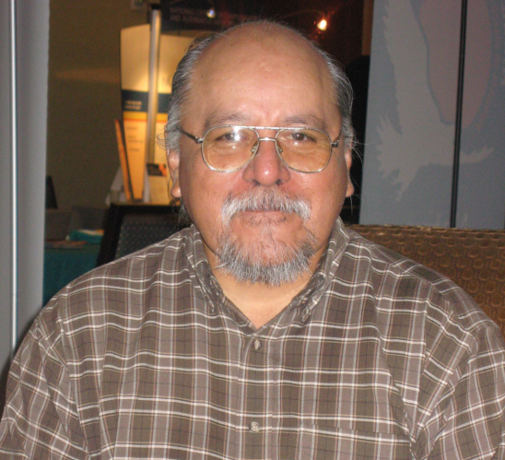
Future Plans
Recruit new mentees each year
Further refine the mentor role and recruit new mentors
Recruit new senior non-Native researchers as associates
Continue to develop relationships with the IHS and professional health organizations
Continue to develop a National University Consortium for Native Health Research
Apply for National Mentoring Network Grant

Slide 25
Contact us at
503.494.3703
E-mail
Dale Walker, MD
onesky@ohsu.edu
Or visit our website:
www.oneskycenter.org

